Slide 1
Metro Transit System Safety
Notes:
Note: The screen settings are set to fit wide screen monitors.
If you need to print your slides be sure to check “scale to fit” in your print settings.

Slide 2
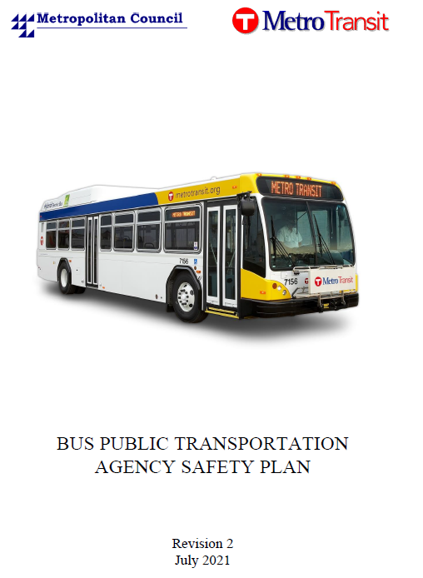
Background
New FTA Rule
  Required agencies to create Safety Plans and management systems
  Required agencies to maintain documentation
2 ASPs – one each for LRT, Bus
  Northstar covered by FRA
MnOSSO oversees the LRT plan
  Triennial Audits
HR 9-1A
  Council procedure that creates occupational health programs.

Slide 3
Objectives and Scope
Objectives
  Determine bus compliance with 49 CFR Part 673
  Follow-up on CAPs from the MnOSSO review
  Evaluate implementation of safety-related procedures and processes
Scope
  Most recent ASPs for bus and rail, and their supporting documents
  Limited to Metro Transit operations

Slide 4
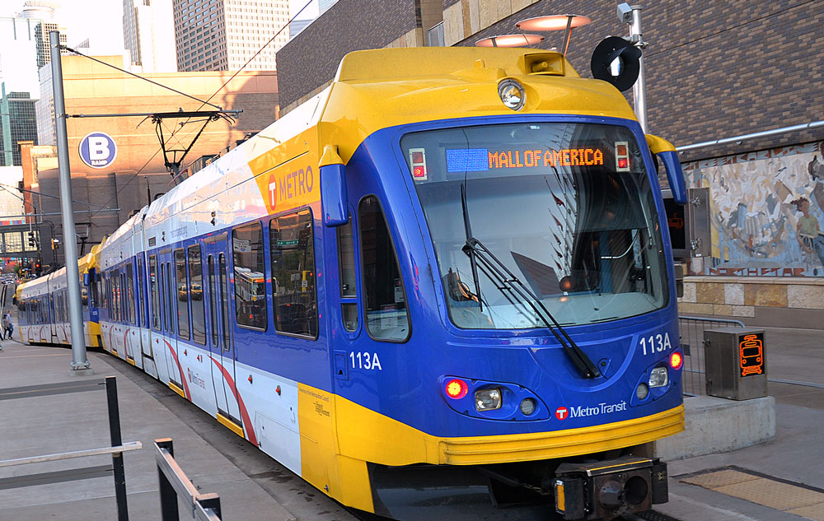
Methodology
Interviews
Document Review
Onsite Review

Slide 5
OBSERVATIONS

Slide 6
Non-Finding Observations
The ASP includes the elements required by 49 CFR Part 673
MnOSSO Corrective Action Plans have been implemented
Corrective Action Plans are consistently documented
A useful regimen is in place for safety incidents
All necessary programs from HR9-1A are present
Necessary trainings and supporting documents are present

Slide 7
Documentation was generally maintained, with 2 exceptions.
Commercial Drivers License daily checks
  Cause:
    State changed their system, locking the Council out.
  Effect:
    CDLs have not been regularly checked since May, creating liability risk
Hazard Analyses
  Cause:
    ASP does not set parameters for when hazards should be evaluated
    ASP does not describe how hazards should be documented
  Effect:
    Increased injury, compliance, and liability risk
    Appearance of randomness
    Not meeting federal documentation requirements.

Slide 8
Recommendations
Complete the interagency agreement and return to completing regular CDL checks.
Create and implement a procedure for documenting hazard analyses.

Slide 9
Workplace housekeeping can be improved.
Some workspaces had employees’ personal items, cluttered tabletops, and general debris.
Cause
  Exact causes were unclear
  COVID-19 restrictions may have contributed
  No formal method to ensure orderliness
Effect
  Poor housekeeping could result in injuries.

Slide 10
Recommendations
Safety specialists should work with work area owners to improve maintenance. Management should determine a method that allows employees to take their breaks in the designated areas. Management should consider a formal workplace housekeeping method.

Slide 11
QUESTIONS?

