Slide 1
Minnesota Disparity Study Results
Metropolitan Council
Ashanti Payne
September 2025

Slide 2
State of Minnesota Disparity Study
Metropolitan Council
Keen Independent Research LLC (Keen Independent) conducted this disparity study to analyze whether there are disparities in the utilization of minority- and woman-owned businesses (MBE/WBEs) in Met Council contracts and subcontracts.
The Council participated in this joint disparity study with 15 other public entities in Minnesota
Keen Independent performed the previous joint disparity study led by the Minnesota Department of Administration in 2017 (Met Council was a participant).
The 2025 Study also examined small businesses and firms owned by veterans, service-disabled veterans and people with a disability
The study was launched in early 2024 and completed mid 2025

Slide 3
Participating Entities:
City of Bloomington
City of Brooklyn Park
City of Minneapolis
City of Rochester
City of Saint Paul
Hennepin County
Hennepin Healthcare System
Metropolitan Airports Commission
Metropolitan Council
Metropolitan Mosquito Control District
Minnesota Department of Administration
Minnesota Department of Transportation
Minnesota State Colleges and Universities
Ramsey County
Saint Paul Public Schools
University of Minnesota

Slide 4
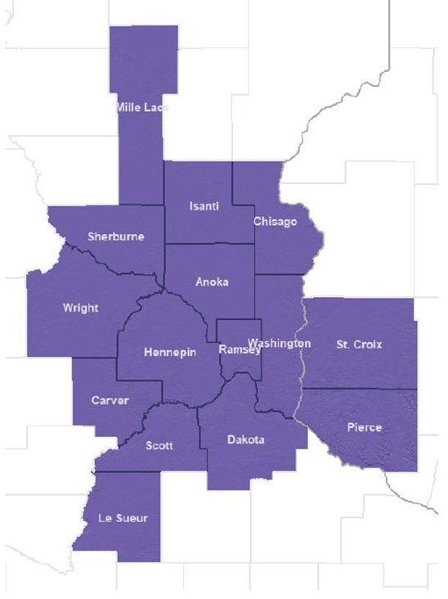
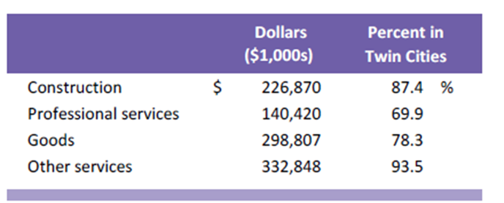
Metropolitan council Procurements Examined
Geographic Market Area
Dollars of Prime and Subcontracts

Slide 5
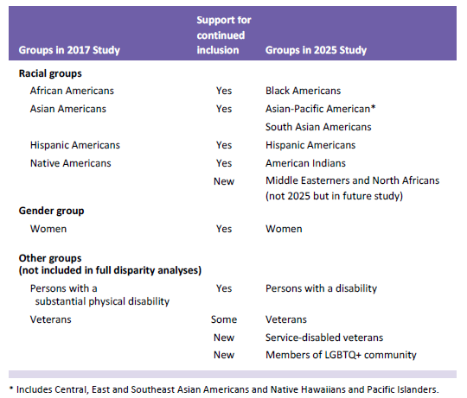
Groups of Business Owners Examined:

Slide 6
State of Minnesota Disparity Study
Results:
Met Council’s utilization of minority-owned firms doubled from what was found for July 2011–June 2016 to reach 5.2 percent for July 2016–June 2023
Met Council utilization of WBEs also increased to 3.8 percent of contract dollars for July 2016–June 2023 (substantially below the 8.2 percent availability)
Met Council’s MCUB Program brought overall MBE utilization (5.2%) to the level that might be expected from the availability analysis
However, the MCUB Program did not eliminate the substantial disparities found in the 2017 Study for Black American-, Hispanic American- and American Indian-owned firms
The new study also found a disparity for South Asian American-owned firms
Combined, MBE/WBE participation was 9.0 percent for Met Council from July 2016 through June 2023, substantially below the 13.4 percent expected from the availability analysis

Slide 7
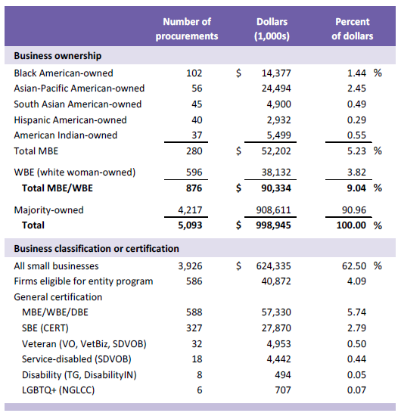
Share of Council Contract Dollars going to MBEs, WBEs and other Firms:

Slide 8
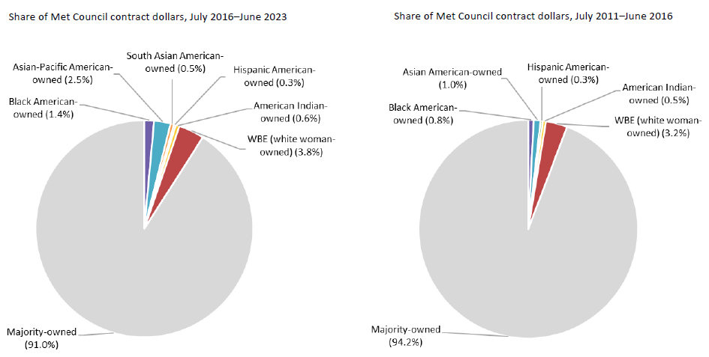
Comparing Results from 2017 Study

Slide 9
Council Contract Dollars going to MBE/WBEs (July 2016–June 2023)

Slide 10
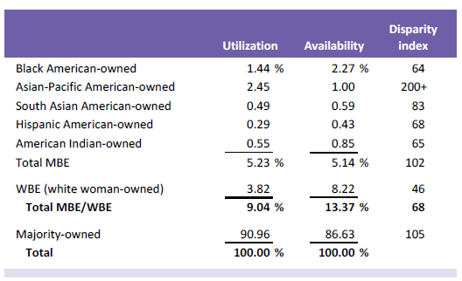
Disparity Analysis By Group:

Slide 11
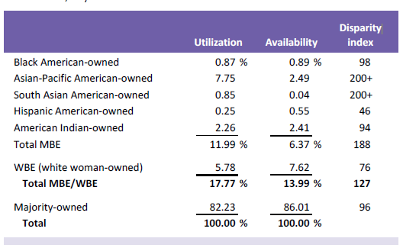
Disparity Analysis By Industry (Construction):

Slide 12
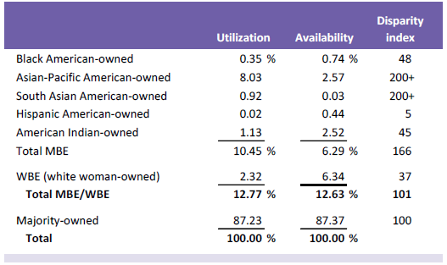
Disparity Analysis By Industry (Construction/Prime contracts):

Slide 13
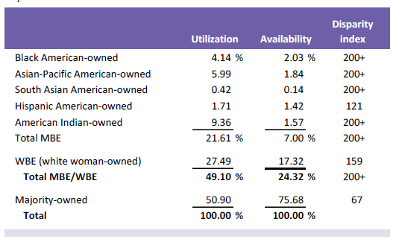
Disparity Analysis By Industry (Construction/Subcontracts):

Slide 14
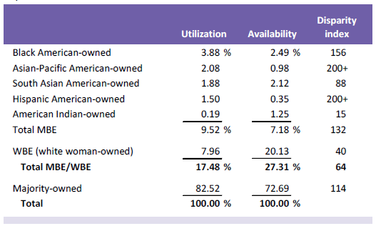
Disparity Analysis By Industry (Professional Services):

Slide 15
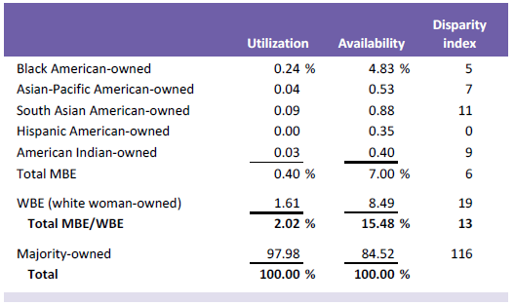
Disparity Analysis By Industry (Goods):

Slide 16
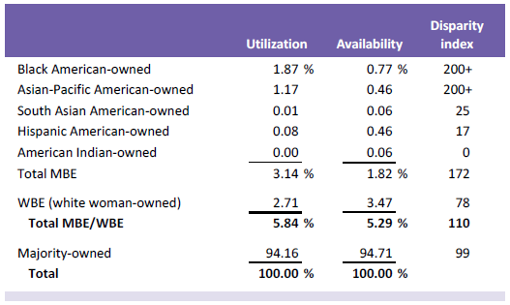
Disparity Analysis By Industry (Other Services):

Slide 17
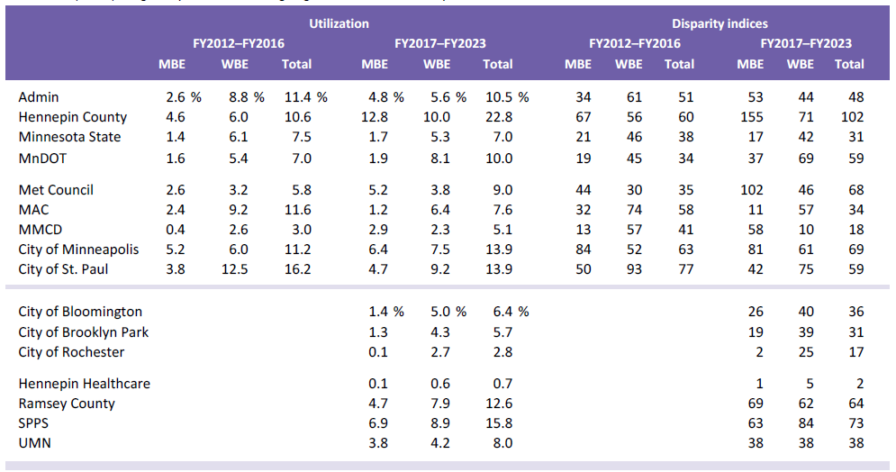
Utilization and Disparity Results for All Participating Entities:

Slide 18
Small Business Program
Recommendations and Implementation
Ashanti Payne, Asst. Director OEEO

Slide 19
1). Approval & Implementation of “Small Business Spend Plan Policy”
Full authorization and utilization of engagement and procurement tools for small business provided by Legislative Authority and Policy that includes intentional planning, accountability and shared responsibility across the organization:
MCUB Direct – Ability to spend up to $25K without a competitive solicitation
MCUB Select (Sheltered Market) - Allows for solicitations up to $175,000 (No cap for State agencies and Hennepin County) competitively bid exclusively by MCUB firms when there are likely Three MCUBs that will respond. The Council should remove the $175K cap.
De-budling scopes of work into packages that are sized for small businesses that are like to bid.
Develop and monitor metrics to gauge success.

Slide 20
2). Development and implementation of Metropolitan Council Small Business Program (MSBP)
Develop a small business program similar to Hennepin County’s “Small Construction Roster Program that is based on size of businesses and annual gross receipts.
Emerging Small Businesses ------ 3 years annual gross receipts of $4 million and under.
Small Business Enterprise ------- 3 years annual gross receipts above $4 million but under $9.5 millions
Targeted Small Businesses ------- 3 years annual receipts above %9.5 million and under $ 12 millions
This would also include support the decision to move to a new certification portal and DBE System Directory (B2G Now). MnDOT has secured funding to cover all costs for MnUCP members for the 1st year. We would include in this request to shift our current MCUB Directory to B2G Now as well. This shift would support external contractor efforts with included functionality to search for firms based on size determinations.. This would also save the Council money and additional resources needed for certification and program administration.

Slide 21
4). Dedicated funding for continued administration of the Council’s Supportive Services program for Certified Small Business
Hennepin County has been operating the Elevate Hennepin program
Hennepin County has been operating the Elevate Hennepin program. The Council’s program is operating with Thrive Equity funds that will run out soon. These efforts provide technical training, business consultation and connections to resources that assist contractors with navigating the challenges of working with a public agency, and build capacity to compete effectively for opportunities.

Slide 22
5). Strengthen the Council’s Prompt Payment monitoring & Compliance and Change Order Process
Prompt Payment is the number one issue identified by certified small business as a barrier to their successful completion of Council projects.
Alternative Dispute Resolution language for Contractor-initiated change orders
Escalation of non-payment after 30 days
Penalties for non-payment in violation of State and/or federal prompt payment requirements
Clear and transparent reporting of payments, non-payments and penalties for late/non-payment.
Project Bank Account for large capital projects (GLE, BLE)

Slide 23
Ashanti Payne
Assistant Director, Office of Equity & Equal Opportunity
Ashanti.payne@metc.state.mn.us

