Slide 1
Imagine 2050 Land Use 60% Draft
Land Use Advisory Committee
LisaBeth Barajas and Angela R. Torres
May 16, 2024

Slide 2

Today’s Conversation
Agenda
Big picture review
Overview and update since last meeting
Wrap up including Next Steps for LUAC
Substantive updates
Review of changes by objective

Slide 3
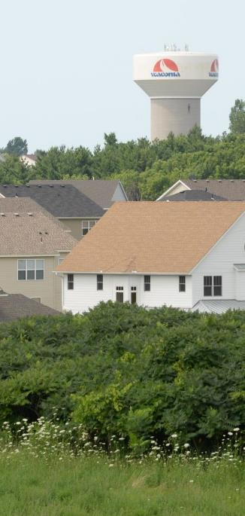
Focus for 2050
A people-centered approach - Elevate the voices of underrepresented communities; value their feedback in equal measure; consider the individual experience within the built form.
Manage growth responsibly and respectfully - Balance competing interests and perspectives of many stakeholders and partners
Aligning need with opportunity - People have what they need within a proximity they choose, with travel and housing options that meet their needs
Community connections - Support communities of all types and re-establish social connections
Natural systems - Value the environment more holistically, including all living beings; more than just for extractive value.
Climate resilience - Through an EJ lens, focus adaptation and mitigation measures to build local climate resilience through development practices
Equitable development - Remedy discriminatory land use practices
Economic wellbeing – Support the economic health of people, address economic inequities, and foster a green economy

Slide 4
What’s happened in 30 days?
18 Apr.
Special Meeting of the Land Use Advisory Committee
24 Apr.
Regional Land Use Policies Local Government Focus Group Meeting #4
26 Apr.
Community Leader Technical Advisory Group Meeting #4
1 May
RDG Council Member Work Group
8 May
Regional Land Use Policies Local Government Focus Group Meeting #5
15 May
RDG Council Member Work Group
15 May
Committee of the Whole
16 May
Land Use Advisory Committee
20 May
Community Development Committee
17 Apr.
Committee of the Whole
Notes:
Darker green includes external stakeholders
Lighter green includes Council member engagement
This doesn’t include the American Indian Advisory Council , which had two meetings during this time, but didn’t solely focus on land use.

Slide 5
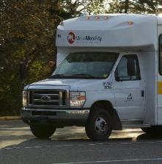
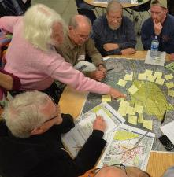
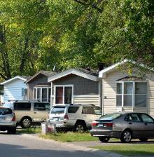
Response to comments
Key takeaways
Need for clear identification of Council and/or Community Roles
  Who is responsible?
Need for all community types to be able to “see” themselves in the plans
  Urban, Suburban, and Rural as well as Community
Local governments
  Uncertain about what requirements will result from new policies
  Support for connections between land use and other policy areas
  Support for technical assistance and planning resources
  Need for ongoing discussions as policy plans continue to develop

Slide 6
Big picture review
Broad Changes
Context and Statute
Added introductory language
Reorganization and consolidation for clarity and reduced repetition.
Clarified and reorganized, where needed
Consolidated and reduced repetition
Used more concise language
Used terminology consistently
Added links to resources referenced within content
  Added context around concepts (rolling land supply), terms (nature-based approaches), principles (universal design), or examples for better understanding of purpose and intended outcomes.
Added missing language or clarification for Statutory requirements:
    Aggregate resources
    Historic preservation and cultural assets
    Climate change requirements
    Planning for access to solar
Notes:
Measuring the feasibility of demand and development of land uses within different communities, ensuring that both the intensity (density range) and location of planned developments are practical differentiates between what is merely allowed and what is plausible, providing a realistic framework for land use planning. Communities would be compelled to plan land uses that are realistically marketable within the planning period, focusing on plausibility and long-term viability. This approach encourages realistic planning and helps prevent the overestimation of development outcomes, thereby reducing the risk of underutilized infrastructure, inefficient land management, and implausible planned densities.

Slide 7
Substantive changes
Density Analysis Report Finalized
Added approach to evaluate feasibility of demand and development of land uses based on practicality.
Ensures both the intensity (density range) and location of planned developments are practical.
Differentiates between what is merely allowed and what is plausible.
Provides a realistic framework for land use planning.
Plan for land uses that are realistically marketable within the planning period.
Prevent the overestimation of development outcomes.
Reduces the risk of underutilized infrastructure, inefficient land management, and implausible planned densities.
Notes:
Measuring the feasibility of demand and development of land uses within different communities, ensuring that both the intensity (density range) and location of planned developments are practical differentiates between what is merely allowed and what is plausible, providing a realistic framework for land use planning. Communities would be compelled to plan land uses that are realistically marketable within the planning period, focusing on plausibility and long-term viability. This approach encourages realistic planning and helps prevent the overestimation of development outcomes, thereby reducing the risk of underutilized infrastructure, inefficient land management, and implausible planned densities.

Slide 8
Substantive changes
More than one housing type
Context for Orderly Annexation
More than one housing type required in residential land use categories
  Requires density ranges broad enough to accommodate more than one housing type.
  Previously included in the housing objective.
  Added support for protection of long-term viability of growth and development of Rural Centers.
  Added Council evaluation of impact of interim uses in rural areas where the extension of long-term regional service may be under consideration or planning to ensure conformance with regional system plans and avoid departures from those plans.

Slide 9
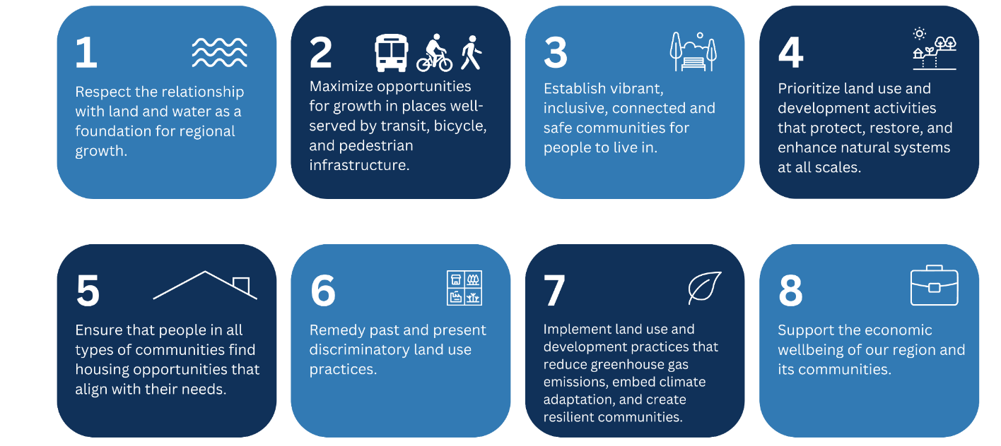
Land Use Objectives
Notes:
With land use objectives we were trying to do multiple things. Of course, trying to address key land use issues focusing on managing growth and development in the region.
We did want to make sure that we were being impactful with each objective, so trying to ensure that each objective impacted more than one regional goal; taking the time to ask, “what will it take to achieve those five cross cutting regional goals?”
Objectives are the precursor to policy development so this is the laying the foundation for our next steps.
And we want to ensure that the objectives complements the work of other policy areas; that there is shared, consistent language between policy areas. Each policy area supports and works with one another.

Slide 10
General changes by Objective
Objective 1 (growth mgmt)
Objective 2 (transportation)
Context for rolling land supply
Added support for Green Acres program alongside Ag Preserves Program
Combined redevelopment content from housing objective
Refined language from density approaches discussion in the Density Analysis Report
Added context and support for development and land use stewardship that integrates natural systems in design and implementation
Strengthened acknowledgement of existing road system and personal vehicle use
Opportunity for connected uses in proximity to daily needs
Added support for residential growth and supportive commercial growth through mixed uses with multiple travel choices
Added support for vehicle-dependent uses like industrial, freight, and warehousing development around existing infrastructure availability

Slide 11
General changes by Objective
Objective 3
Objective 4 (natural systems)
Strengthen concepts around connectivity through design; transportation and community connections
Context for universal design (design for all people; inclusive built environment)
Integrated references from other objectives about green infrastructure
Clarification on meaning of culturally expansive ordinances
Consistently referring to protection, restoration, and enhancement throughout
Some references moved to other objectives to better integrate throughout
Inclusion of water more explicitly within natural systems
Clarification regarding Council and community roles
Changed reference from environmental justice to overburdened communities

Slide 12
General changes by Objective
Objective 5 (housing)
Objective 6 (equity)
Alignment between the Housing Policy chapter and the housing land objective
Housing policy focuses on:
  Homelessness
  Metro HRA and Grant programs (LCA)
Land use objective on housing focuses on:
  Housing within land use categories
  Housing supportive land uses
  Diversity of housing types close to destinations
Added emphasis on accountability through regular reporting and data maintenance
Added procurement process improvements to help remove barriers to engagement with community organizations

Slide 13
General changes by Objective
Objective 7 (climate change)
Objective 8 (economic wellbeing)
Added references to new statutory climate requirements
Overall consolidation, repetition reduction and context improvements
Some references moved to other objectives to better integrate throughout
Clarified urban tree canopy aims, including work on Emerald Ash Borer
Added specificity and clarifying language to food systems policy
Closer tie-ins from the adopted regional Economic Framework
Focus on promotion of a just economy through economic growth and wellbeing through equitable access to economic resources
Notes:
Measuring the feasibility of demand and development of land uses within different communities, ensuring that both the intensity (density range) and location of planned developments are practical differentiates between what is merely allowed and what is plausible, providing a realistic framework for land use planning. Communities would be compelled to plan land uses that are realistically marketable within the planning period, focusing on plausibility and long-term viability. This approach encourages realistic planning and helps prevent the overestimation of development outcomes, thereby reducing the risk of underutilized infrastructure, inefficient land management, and implausible planned densities.

Slide 14
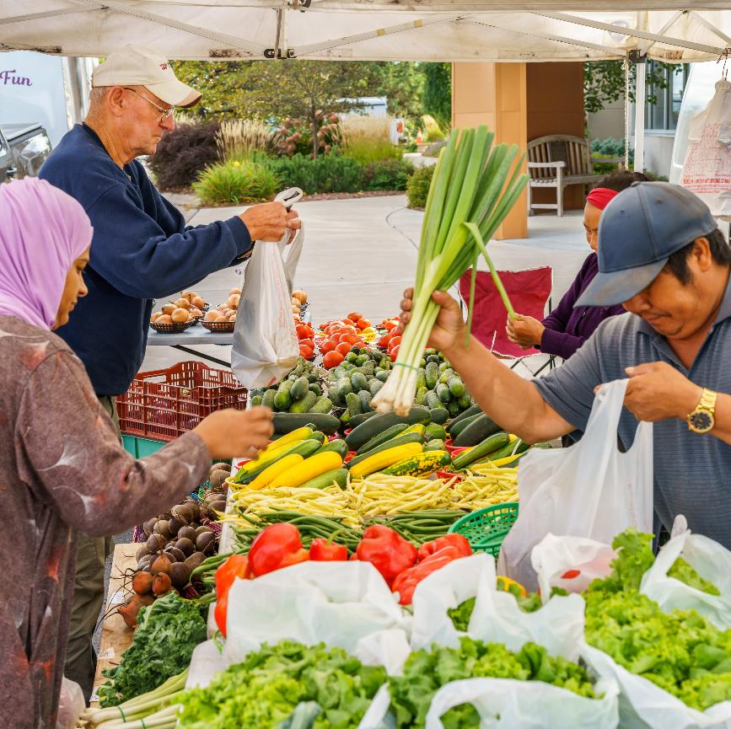
Wrap-up

Slide 15
More Engagement Planned
Internal and external coordination and engagement
Summer engagement opportunities with partners:
  Forecasts engagement through June
  Land use and density summer workshops with Metro Cities
  Regional Planning Advisory Group (Metro Cities) special meeting
  American Indian Advisory Council
  More rural community engagement
Council members
  RDG Council member Work Group
  Council standing committees and advisory committees
Ongoing cross-divisional team coordination
  Integration Team & Policy Leads Team
  Equity Task Force and Environmental Justice Task Force
Notes:
We will be working to coordinate with other policy areas, including internal equity and environmental justice teams.
We continue to work with our local government partners and community organizations and other stakeholders.
As I have said before, lather, rinse, and repeat.

Slide 16
Next Steps for Land Use Policy
Moving towards the public comment draft
Integrate upcoming and ongoing engagement feedback
Review draft language against:
  Equity Framework
  Environmental Justice Framework
  Community-Centered Engagement Framework
  Anti-Displacement Framework
Balance revisions; weigh feedback of underrepresented communities to ensure voices are heard equitably.
Follow Council direction to be bold, address regional racial disparities, and center community voices in policy development.

Slide 17
Next steps for LUAC
Remaining Imagine 2050 tasks
Development of Guidelines and Programs
Review Density Report recommendations
Review TOD density analysis and recommendations
Review of criteria, guidelines, and programs
Criteria for MUSA Expansion
Criteria for performance-based flexibility and program needs (enrollment, eligibility, tracking)
Technical Assistance Programs and Planning Resources
Exploration of Financial Incentives

Slide 18





Timeline
May 20, 2024: Land Use draft review at Community Development Committee
August 5, 2024: Community Development Committee action
August 14, 2024: Met Council action – Release Imagine 2050 for public comment
September 25, 2024 – Tentative formal public hearing
October 7, 2024 – Close of formal public comment period
Chapter Review
Evaluation, Modeling & Mapping
Document Prep & Actions to Release
Comment Period
Revisions
Adoption
Q4 2023
Q1 2024
Q2 2024
Q3 2024
Q4 2024
Q1 2025

Slide 19
Questions
LisaBeth Barajas
Executive Director, Community Development
lisa.barajas@metc.state.mn.us
(651) 602-1895
Angela R. Torres, AICP
Senior Manager, Local Planning Assistance
angela.torres@metc.state.mn.us
(651) 602-1566

