Slide 1
21st Century Paratransit & Special Needs Mobility
Providing High Quality, Cost Effective Transportation for People with Disabilities and Seniors
John Doan
CONFIDENTIAL – DO NOT DISTRIBUTE
Notes:
My name is John Doan and I’m the proud founder and CEO of Mobility 4 All.

Slide 2

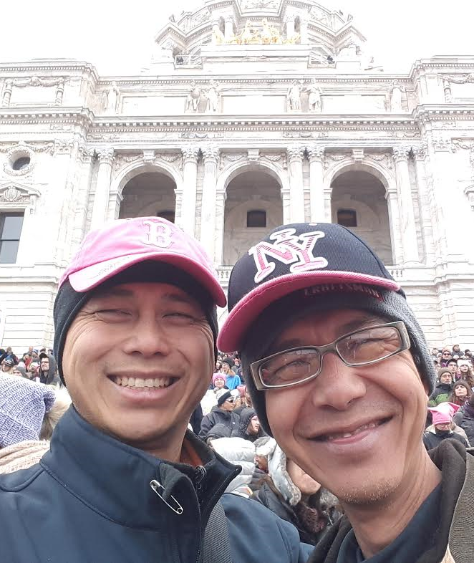
“I AM MY BROTHER’S KEEPER”
Galang Refugee Camp - 1979
MN State Capital - 2017
Notes:
As Vietnamese refugees, we grew up with a single mom, which made Roy my guardian on most days. Roy taught me how to ride a bike, deal with bullies and when I was old enough, how to drive. About 10 years, our lives diverged. Roy was diagnosed with dementia and MS. Suddenly, I became his big brother.

Slide 3

Metro Mobility - Exemplary Paratransit provider compared to peers agencies
Low relative cost (~$30/trip, ~$3/mile)
Expanded service area beyond ADA requirements
Fully ADA Compliant
First and last resort option for door thru door service
Commitment to service
Notes:
https://www.flickr.com/photos/leehaywood/4215672566

Slide 4
Metro Mobility Task Force Charge
13% budget
3% transit trips
  Met Mo is 3% of regional transit trips, consumes 13% of transit budget
  Ballooning demand, rising costs
  Driver shortage
  Service complaints
  Capture positive disruptive influence of TNCs
  Emergence of AV technology
Notes:
According to the legislative language, the report must:
• Describe the current Metro Mobility program
• Summarize the work of the task force and its findings
• Identify options for reducing program costs and improving efficiency
• Identify at least three potential service level approaches that involve partnering with and incorporating transportation network companies, taxi service providers, or both
• Provide any recommendations for program and legislative changes

Slide 5


Mission impossible
Using existing publicly contracted models
6-8% annual demand growth
Sustain reliable, quality service
Reduce costs with driver shortage

Slide 6

Rethinking Paratransit for 21st Century
Existing
Market Place
1 Public agency provider (Met Council)
Platform with unlimited providers (public, private, nonprofit)
3 siloed product lines (fixed route, Met Mo, PSD)
Adaptable, market driven product lines
Long term operating contracts lock in pricing and incentive structure
Ongoing competition drives down costs & incentivizes innovation
Supply constrained
Demand driven
Fixed capital stock
Flexible capital stock

Slide 7

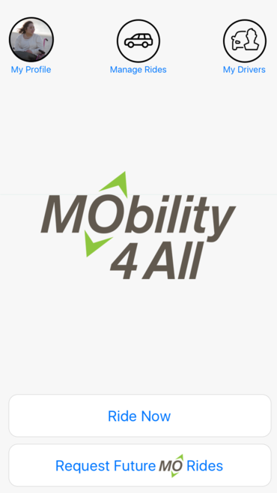






Service, Trust, Respect
TRUST
Service
Respect
Notes:
For Roy and many with people like him, transportation is a daily struggle. Thus, Mobility 4 All was born. We are the kinder, gentler, more patient Uber tailored for seniors and people with disabilities. We are a brokerage platform that matches riders who need door thru door service with thoroughly vetted drivers. The heart and soul of our business is built upon TRUST, SERVICE and RESPECT.

Slide 8
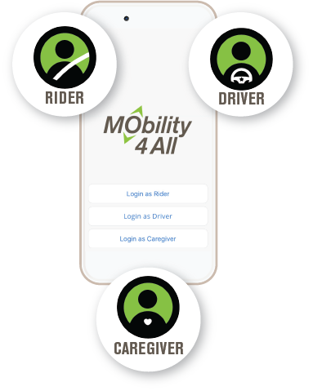
Rider, Driver and Caregiver
Notes:
A key feature is the strength of our 3 legged connection between the Rider, Driver and Caregiver. All parties are connected and stay informed throughout the trip.

Slide 9

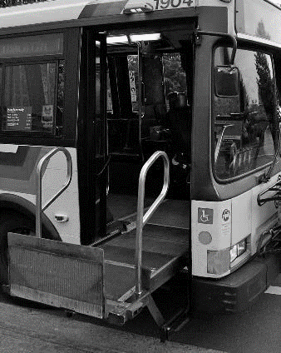
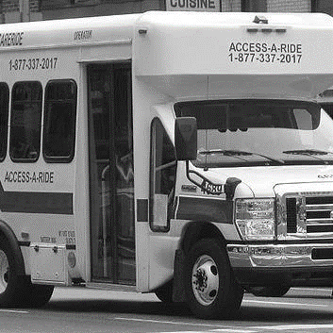


What Mobility 4 All offers
 | Family & Friends | Public Transit | Paratransit | Ride Hailing & Taxis | MO
On Demand
Reliable & Available
Door thru Door, Accessible Service
Highly Vetted & Trained Drivers
Favorite Driver Library
Caregiver & Call Center Support
Streamlined, Accessible Payment Processing
Notes:
MO is the only mobility service that provides reliable, on-demand, door thru door service, with highly trained drivers and the ability to choose favorite drivers, plus MO offers enhanced caregiver involvement, streamlined payment processing and a call center with real people answering the phones. At its essence, MO is curated for people with disabilities and seniors.

Slide 10

Twin Cities Pilot
Proudly partnering with
Pre-pilot testing
Jan 2018
MO Tech platform launches Spring 2018
Official launch Summer 2018

Slide 11
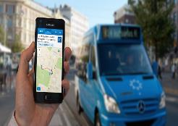
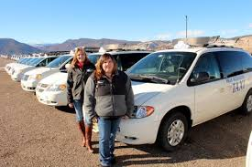
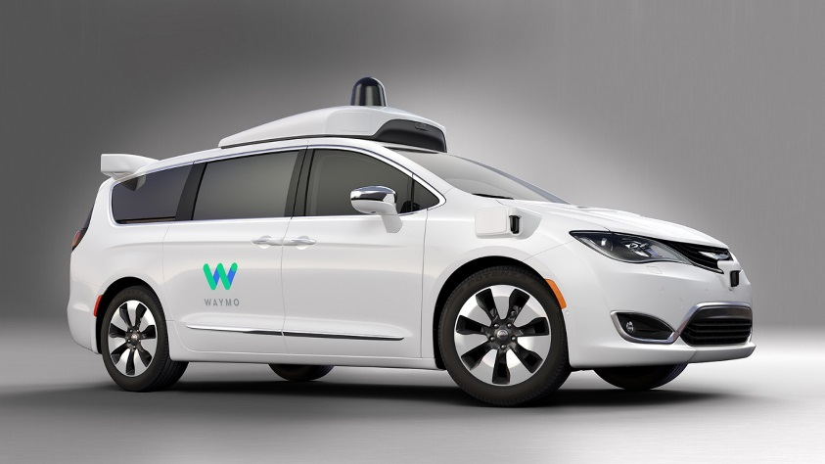
Path to Mobility Independence
Brokerage
B2B Sourcing
Driver Vetting & Training Systems
Call Center
Payment Processing
3+ million rides/year
2,500+ drivers
Graduated driver to
caregiver training
program
Integrate Self
Driving Vehicles
Transition Drivers
to Caregivers
Twin Cities Pilot (2018-2019)
Expansion to 10 US Markets (2019-2020)
Integration of AVs (2021 +)
PHASE 2
Notes:
We’ve developed an interactive prototype and will launch the MO platform in April 2018 in the Twin Cities. Through our B2B approach, we are recruiting customers through relationships with senior living facilities and disability day training centers. Our professional, contracted drivers are sourced from local taxi and special transportation companies, who are anxious to pick up more rides.
In the $10 plus billion dollar US special transportation market, Our growth will take us to 3 new markets in 2019, then 6 more in 2020, for a total of 10 markets by 2021. We project to be revenue positive in the Twin Cities within 4 years and in the black in our expansion markets within 3 years or less.

Slide 12
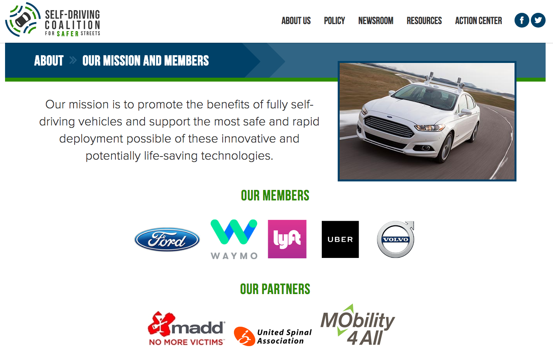
A Proud Member of…….
Notes:
https://www.flickr.com/photos/leehaywood/4215672566

Slide 13
Recommendations
Be BOLD! Small problems can be tweaked, while big problems necessitate systems change
Think out-of-the-box about how to procure new, tiered service options
Give riders and their caregiver choices
Create appropriate incentives for service providers and riders
Allow for cross utilization of assets and providers
Break down funding and regulatory barriers between transit and human service programs
Notes:
1. Consider a goal that by 2020, x% (say 50%) of all paratransit trips will be on demand using a platform service that has a capped subsidy per trip of y (say $15), which is a $7 to $8 savings per trip from traditional Met Mo.

Slide 14
www.Mobility4All.net
John Q Doan
Chief Executive Officer
johnqdoan@gmail.com
763.355.8746
Sebastien Tavenas
Chief Operating Officer
stavenas@gmail.com
917.443.7719
Notes:
You can find us at Mobility“4”All.NET. Thank you for your attention and the basket for your checks is in the back of the room.

