Slide 1
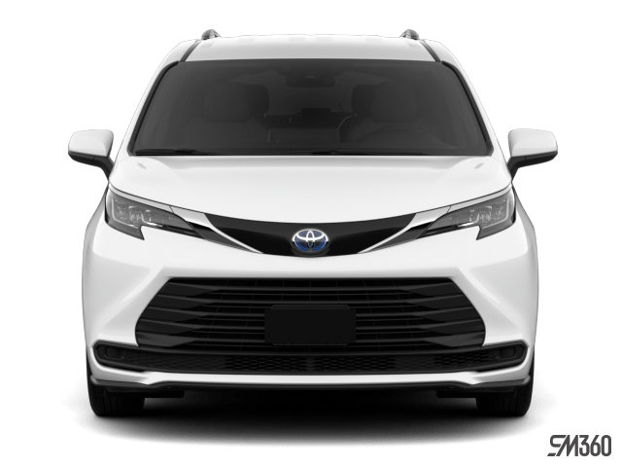
Presenting A
New MTS Fleet Vehicle for TAAC Review
MTS Fleet, Jodi Janssen & Paul Colton

Slide 2
2025 – 2026 Toyota Sienna XLE AWD Hybrid
Key Features
All Wheel Drive
Hybrid Electric / Gasoline
MPG (Miles Per Gallon): 35 City / 36 Highway / 35 Combined
7 Passengers
3 Year / 36,000 Basic Warranty, 5 Year / 60,000 Drivetrain Warranty
Edmunds Rating: 8.3 / 10
Consumer Rating: 4 / 5 Stars

Slide 3
2025 – 2026 Toyota Sienna XLE AWD Hybrid
Dimensions
Ground Clearance: 6.4”
Overall Width (without mirrors): 78.5”
Overall Height: 68.5”
Overall Length: 203.7”
Front Headroom: 40.1”
Front Legroom: 40.3”
Second Row Headroom: 39.3”
Second Row Legroom: 39.9”* (*can be much larger if not using third row)
Rear Row Headroom: 37.4”
Rear Row Legroom: 38.7”
Cargo Space: 33.5 cu.ft.

Slide 4
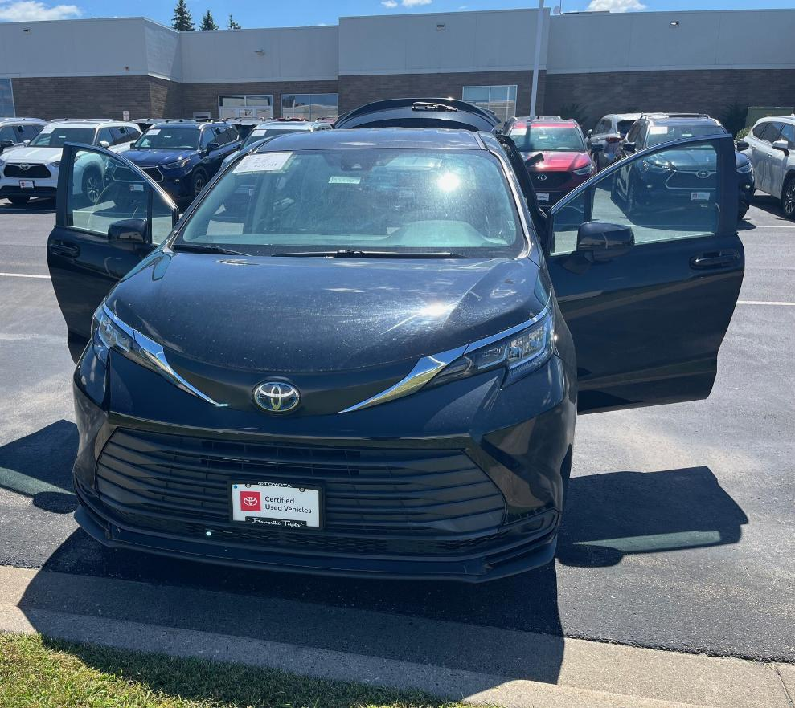
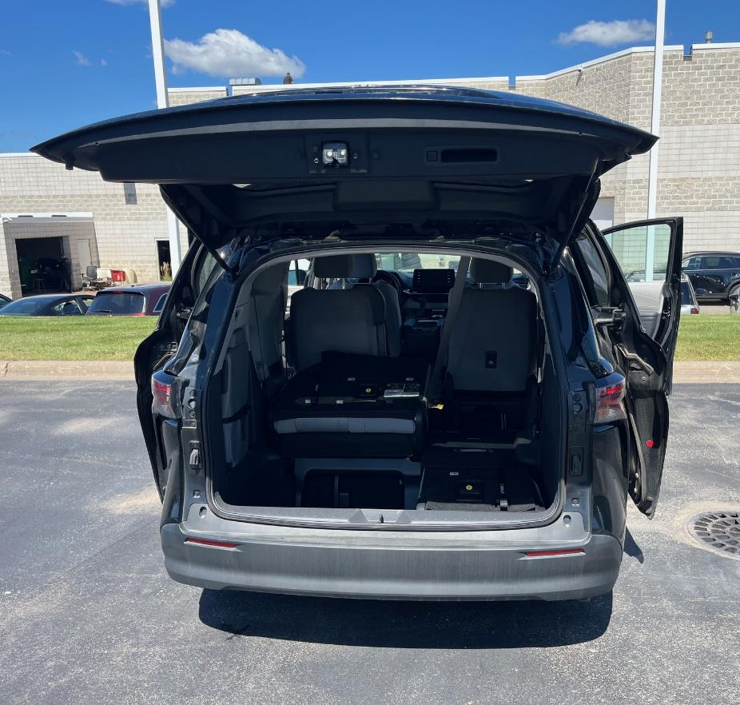
2025 – 2026 Toyota Sienna XLE AWD Hybrid
Photos Taken At Burnsville Toyota

Slide 5
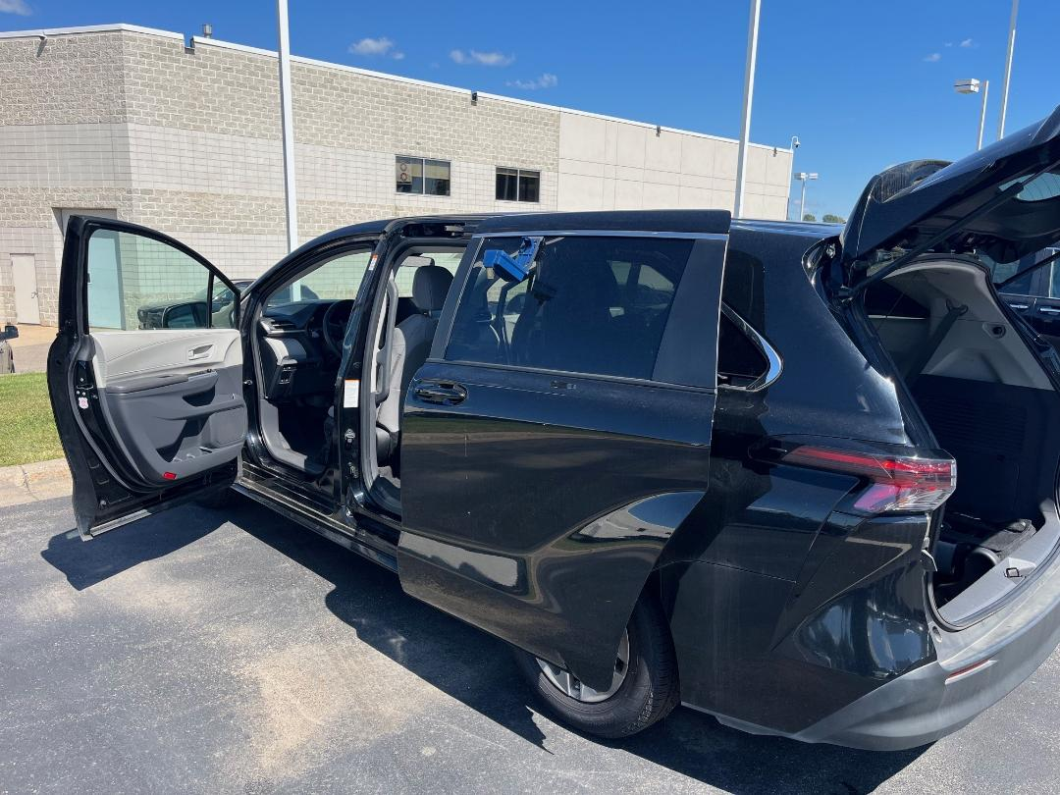
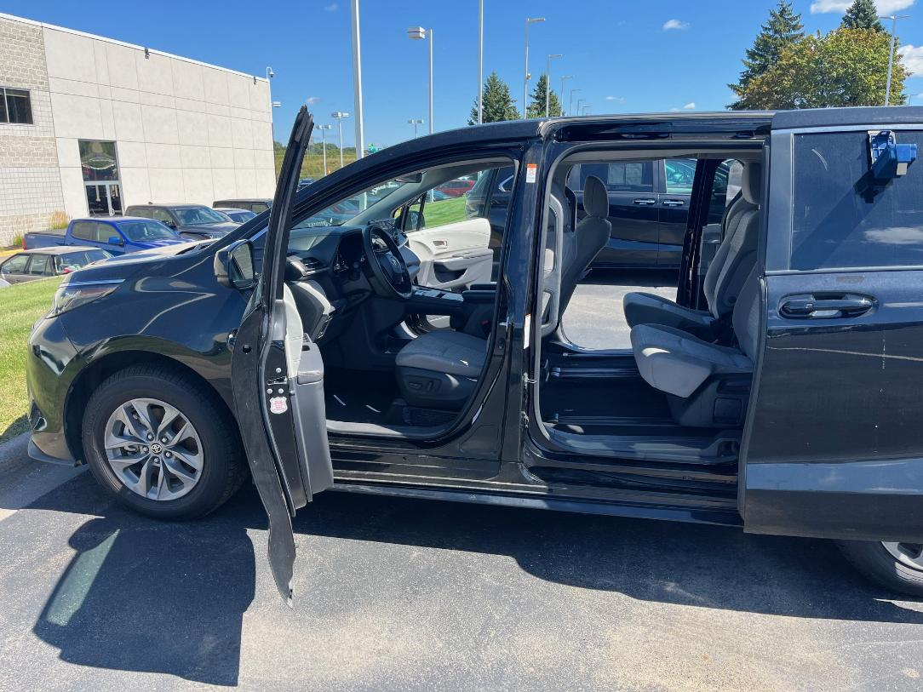
2025 – 2026 Toyota Sienna XLE AWD Hybrid
Photos Taken At Burnsville Toyota

Slide 6
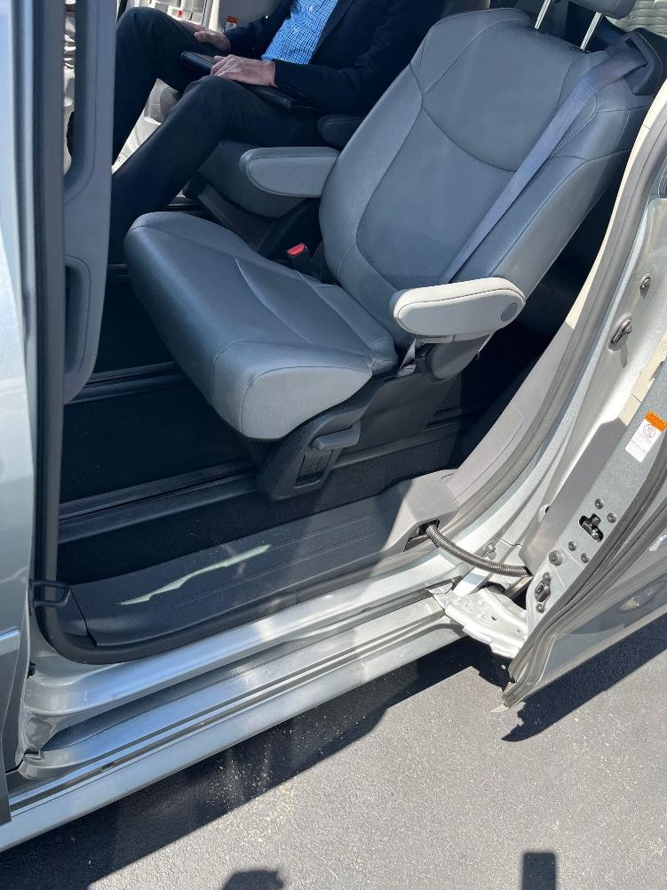
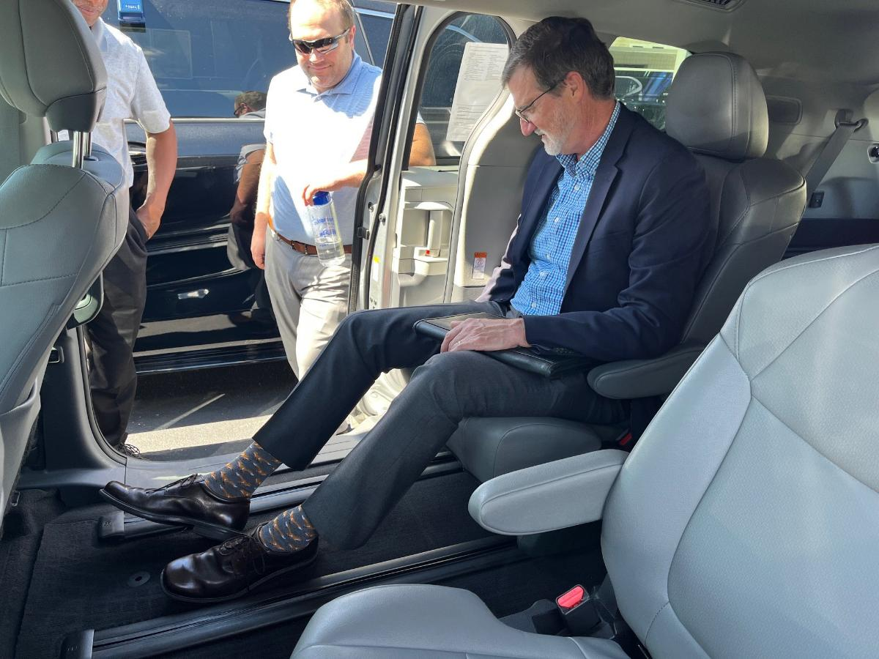
2025 – 2026 Toyota Sienna XLE AWD Hybrid
Photos Taken At Burnsville Toyota

Slide 7
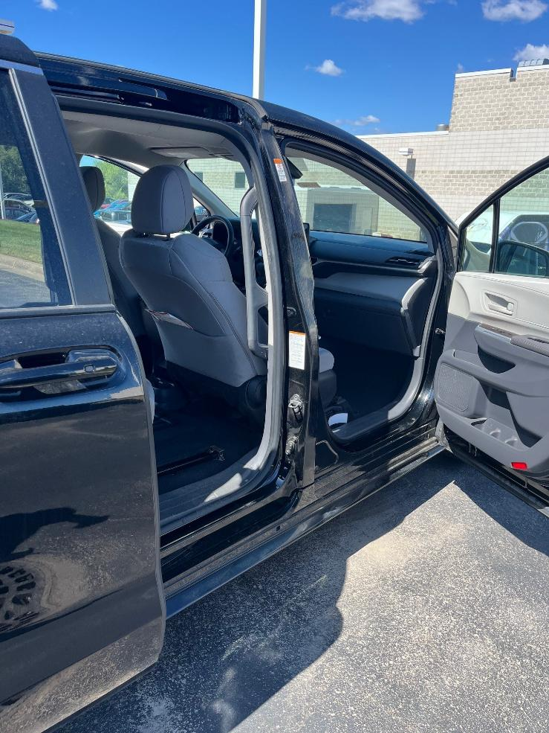
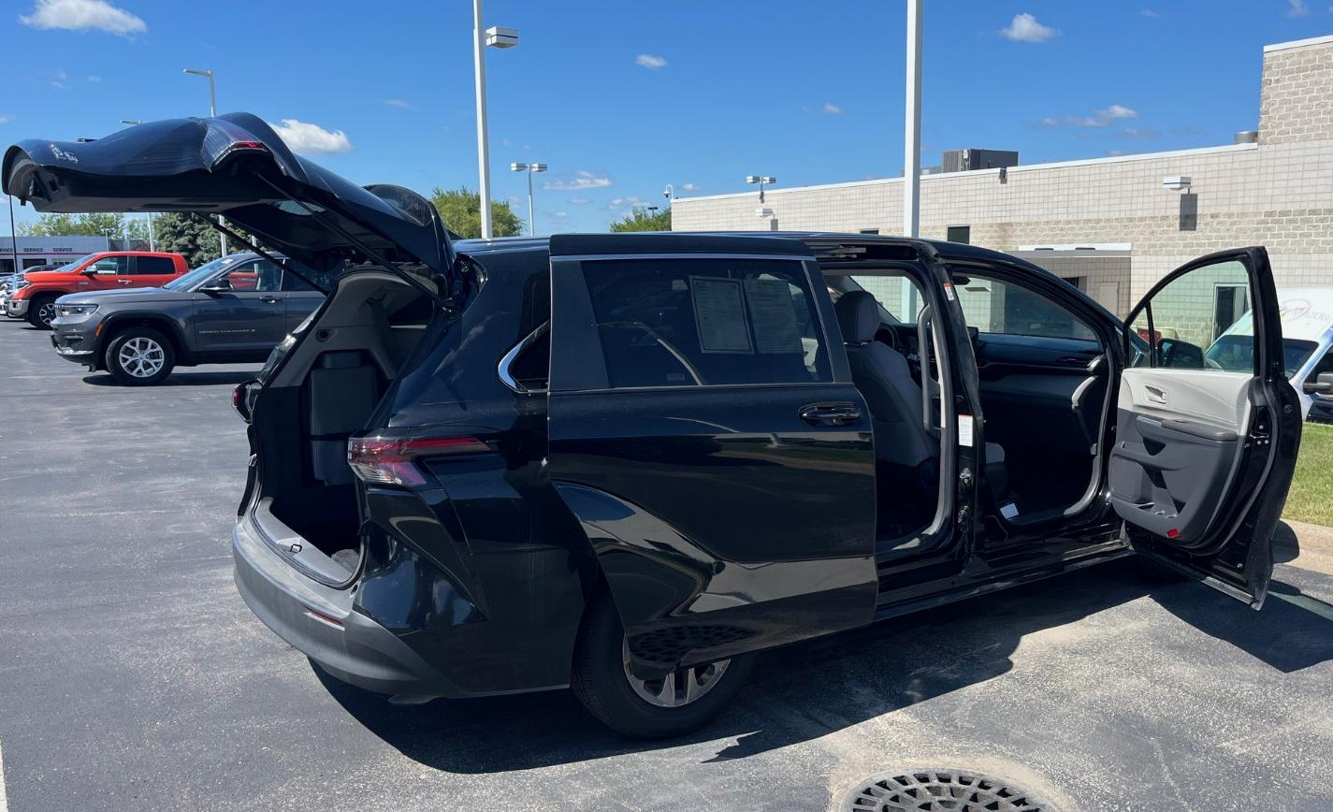
2025 – 2026 Toyota Sienna XLE AWD Hybrid
Photos Taken At Burnsville Toyota

Slide 8
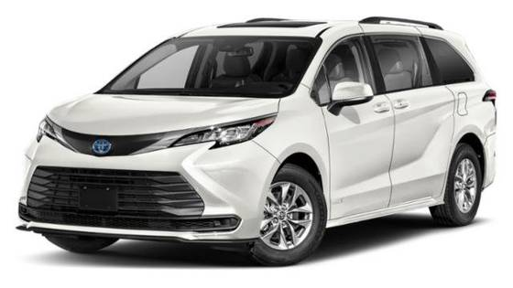
Questions?

