Slide 1
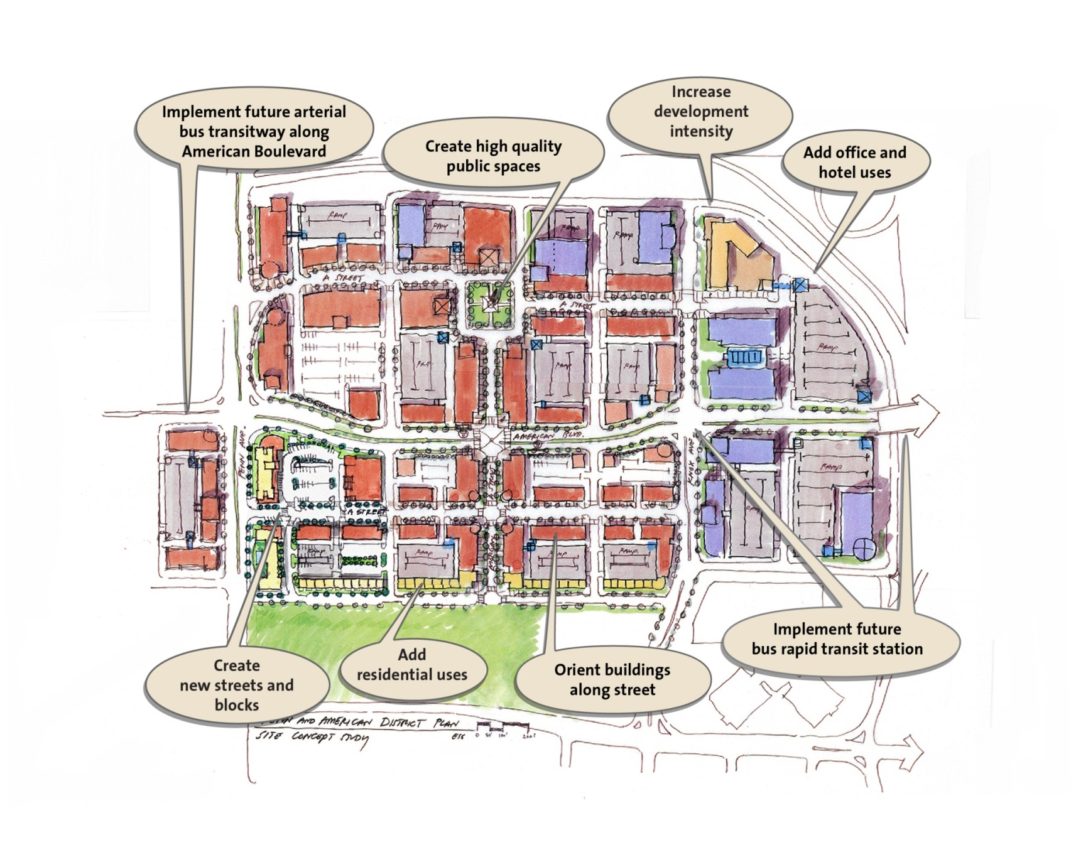
Penn American District Vision

Slide 2
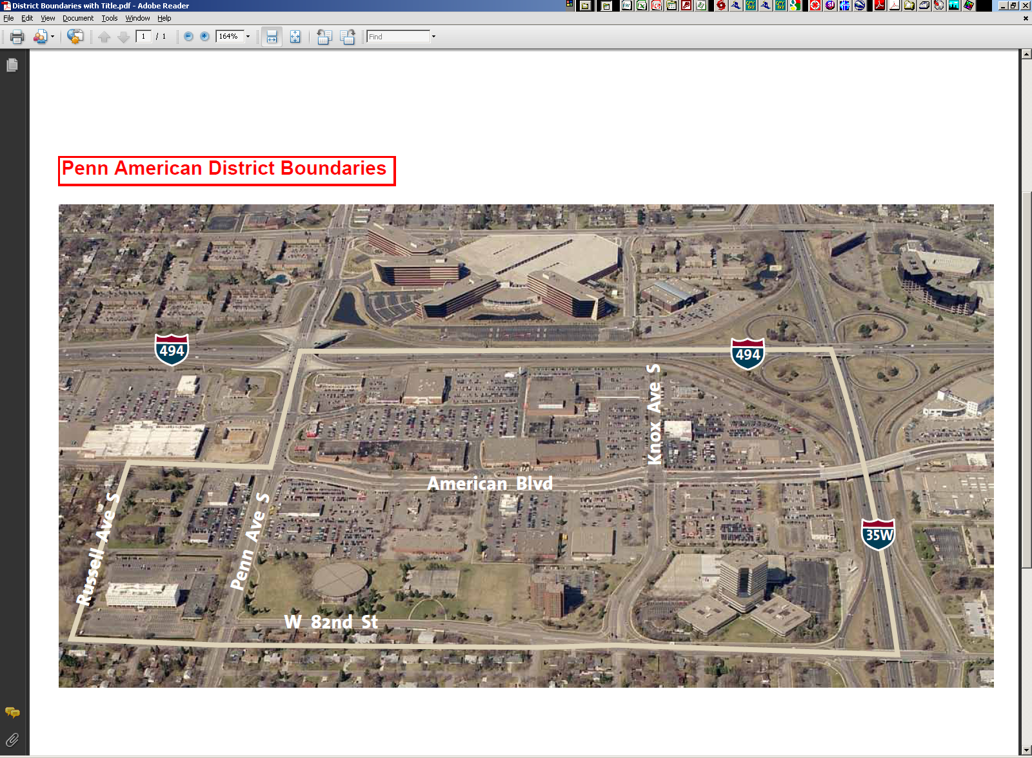
Penn American District
Orange Line BRT
Best Buy
Southtown Center
Auto Dealers
NB
SB
Auto Dealers
Notes:
Located at intersection of regions two busiest highways

Slide 3
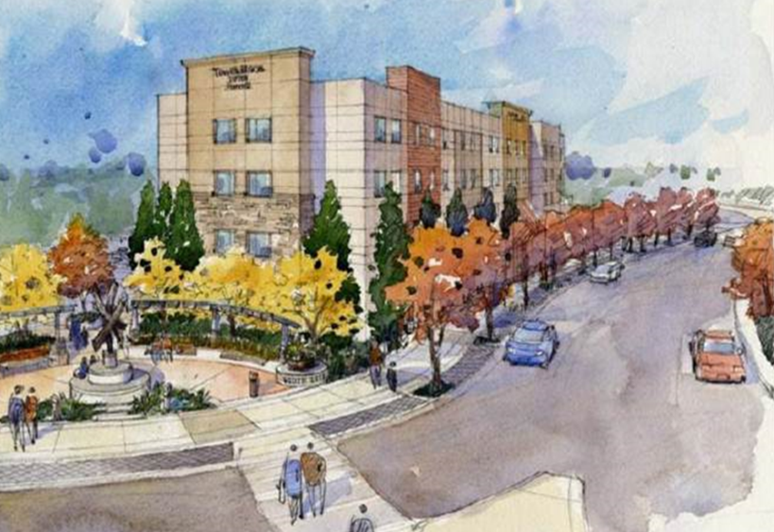
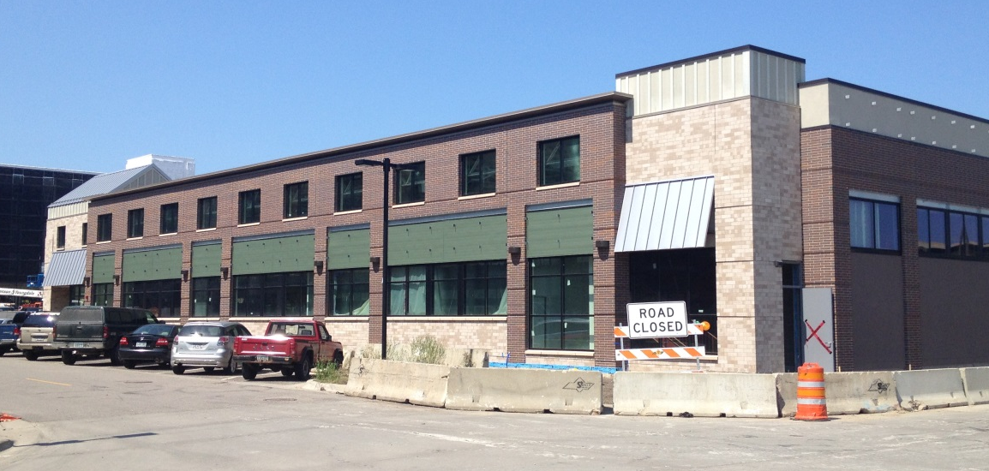
Key Code Modifications
Highest design on “primary” streets
Street enclosure
  Height – feet vs stories
  Landscape, fence/wall, and art alternatives
Parking Flexibility
  Shared
  On-street
  Proof
  Transit proximity & TDM
Primary Street
25 ft min.

Slide 4
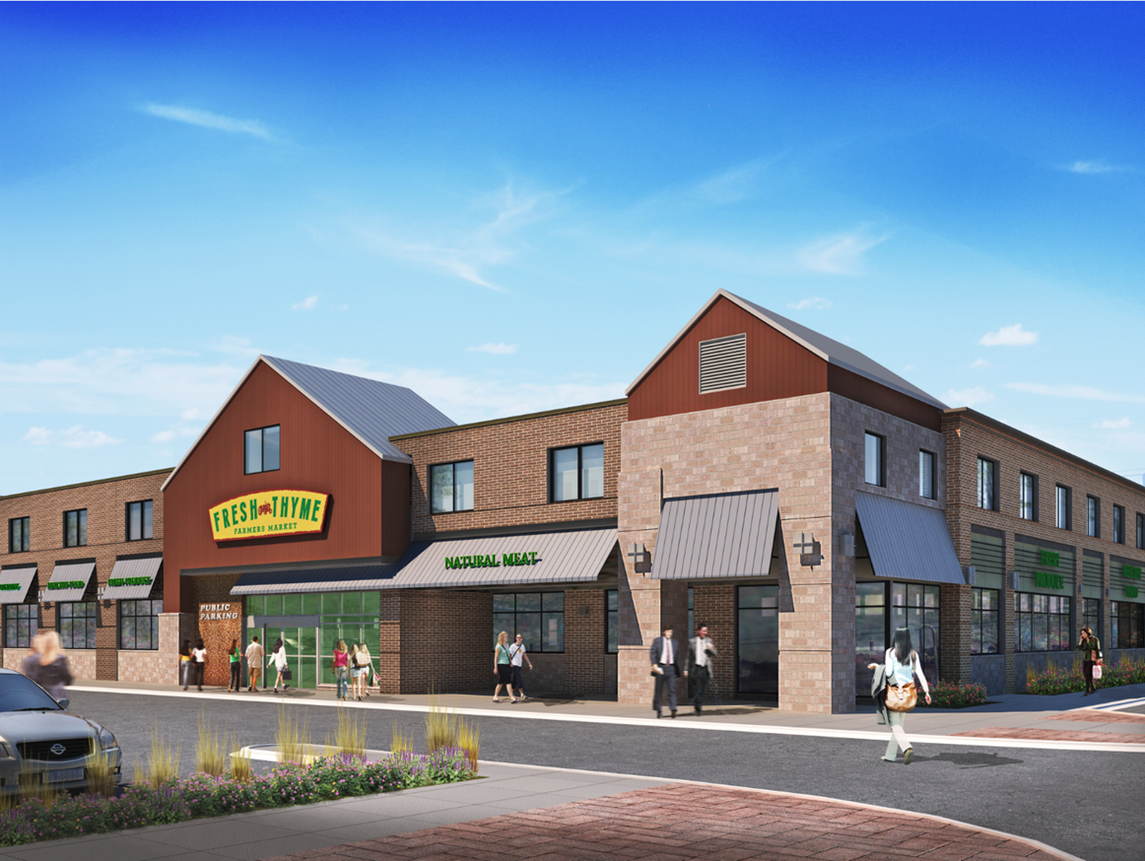
Structure Design Modifications
Windows
  Priority on pedestrian oriented streets
  Focus on ground level vs. entire façade
  Allow alternatives (display boxes; art; wall treatment)
Entrances
  Only on streets with parking

Slide 5
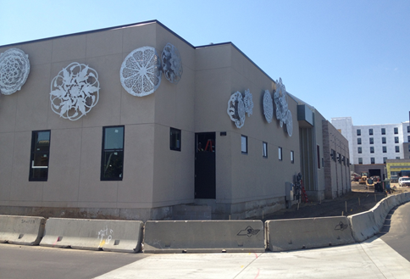
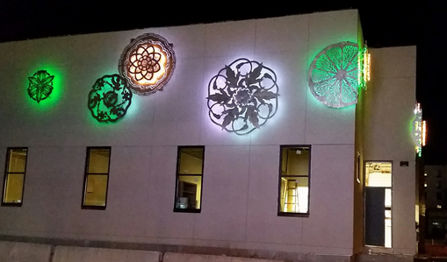
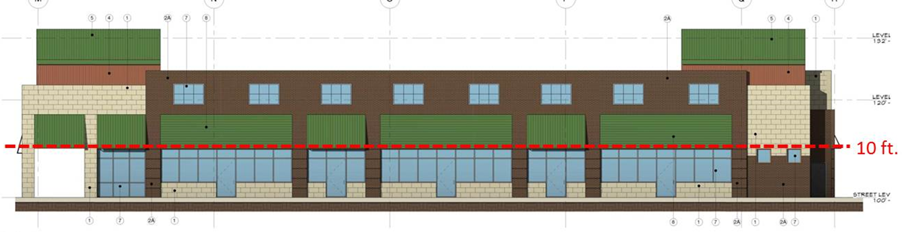

Key Code Modifications
Façade transparency and “activation”
  Only applies to “ground level”
  Window substitutions: art, display boxes, façade decoration
  Entrances only required on streets with parking
Ground Level
Notes:
Market will dictate design along secondary streets

Slide 6
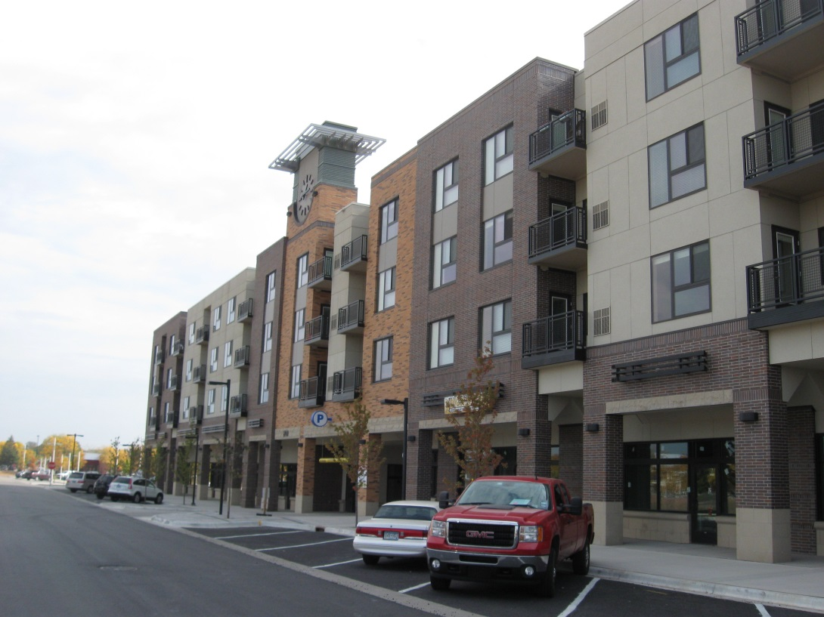
Parking Flexibility (adopted 2006)
Shared parking
Access to transit
Transportation Demand Management (TDM)
On-street parking
Proof of parking
Notes:
SEGUE: Glen will provide an overview of the amendments regarding nonconformities and motor vehicle sales

Slide 7
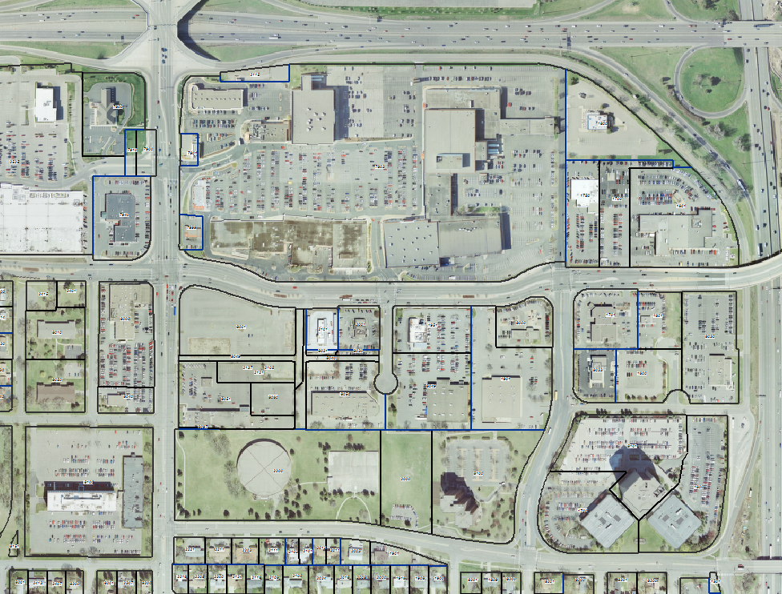
Use Non-Conformities
Vehicle Related
Use Flexibility
Allow existing auto dealers as permitted uses in C-4 and C-5
Vehicle Repair
Vehicle dealerships
Vehicle dealership
Notes:
Auto dealers already allowed in C-1

Slide 8
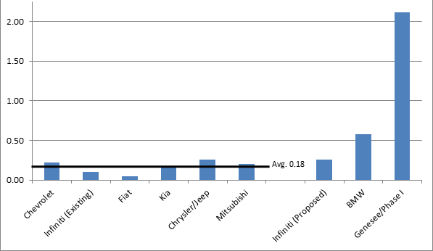
Floor Area Ratio
(Existing Auto Dealers)
C-5/transit station area minimum FAR (1.0)
C-4/C-5 minimum FAR for existing auto dealers (0.6)

Slide 9
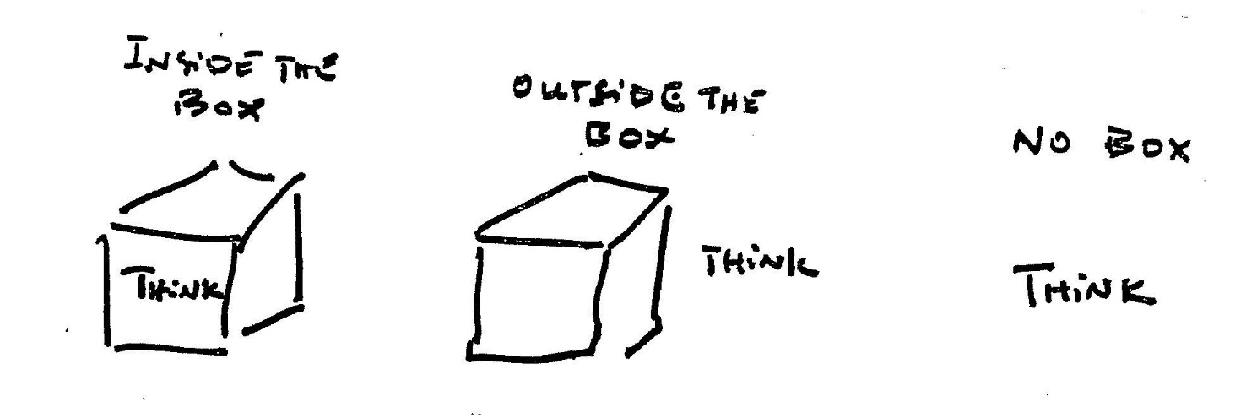
Lessons Learned
Make better, even if not ideal
  Transformation takes time; incremental
  Strive for improvement, not perfection
Working close with affected property owners is key
  Flexibility crucial to smooth transition
  Openness greatly appreciated, builds trust and support
Source: Robert M. Sharlin
Notes:
Small steps in right direction can lead to change in market that will attract development that supports higher development standards, intensity, etc.

Slide 10
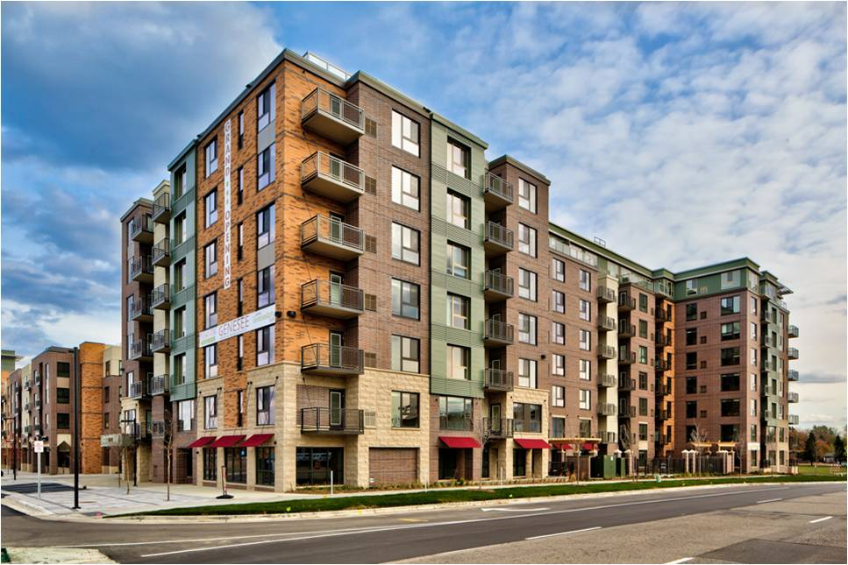

Genesee Development

Slide 11
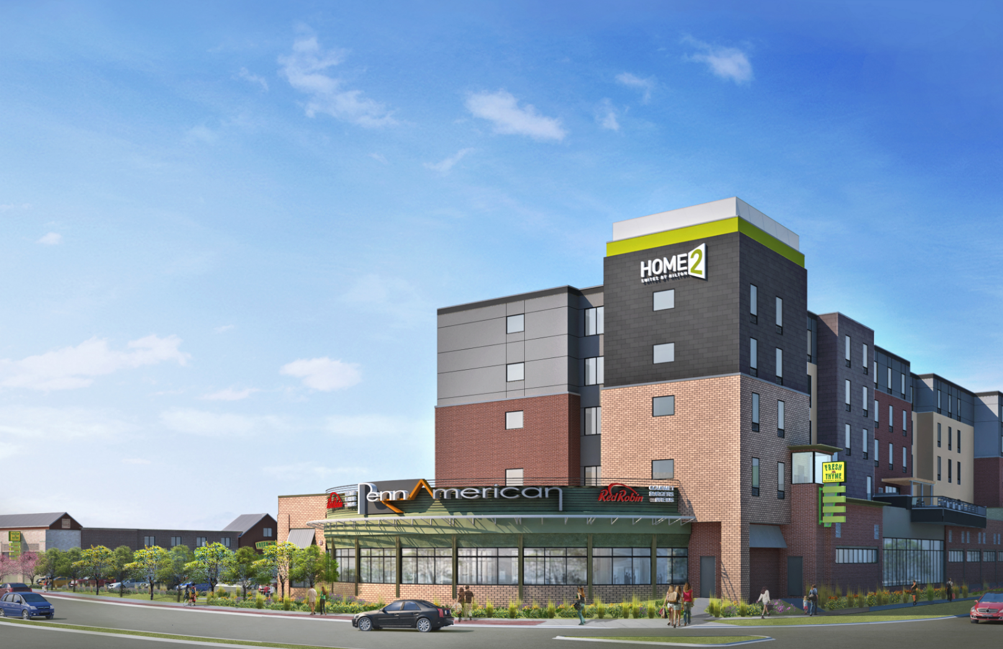
Home 2 Suites by Hilton

Slide 12

Fresh Thyme Farmer’s Market

Slide 13
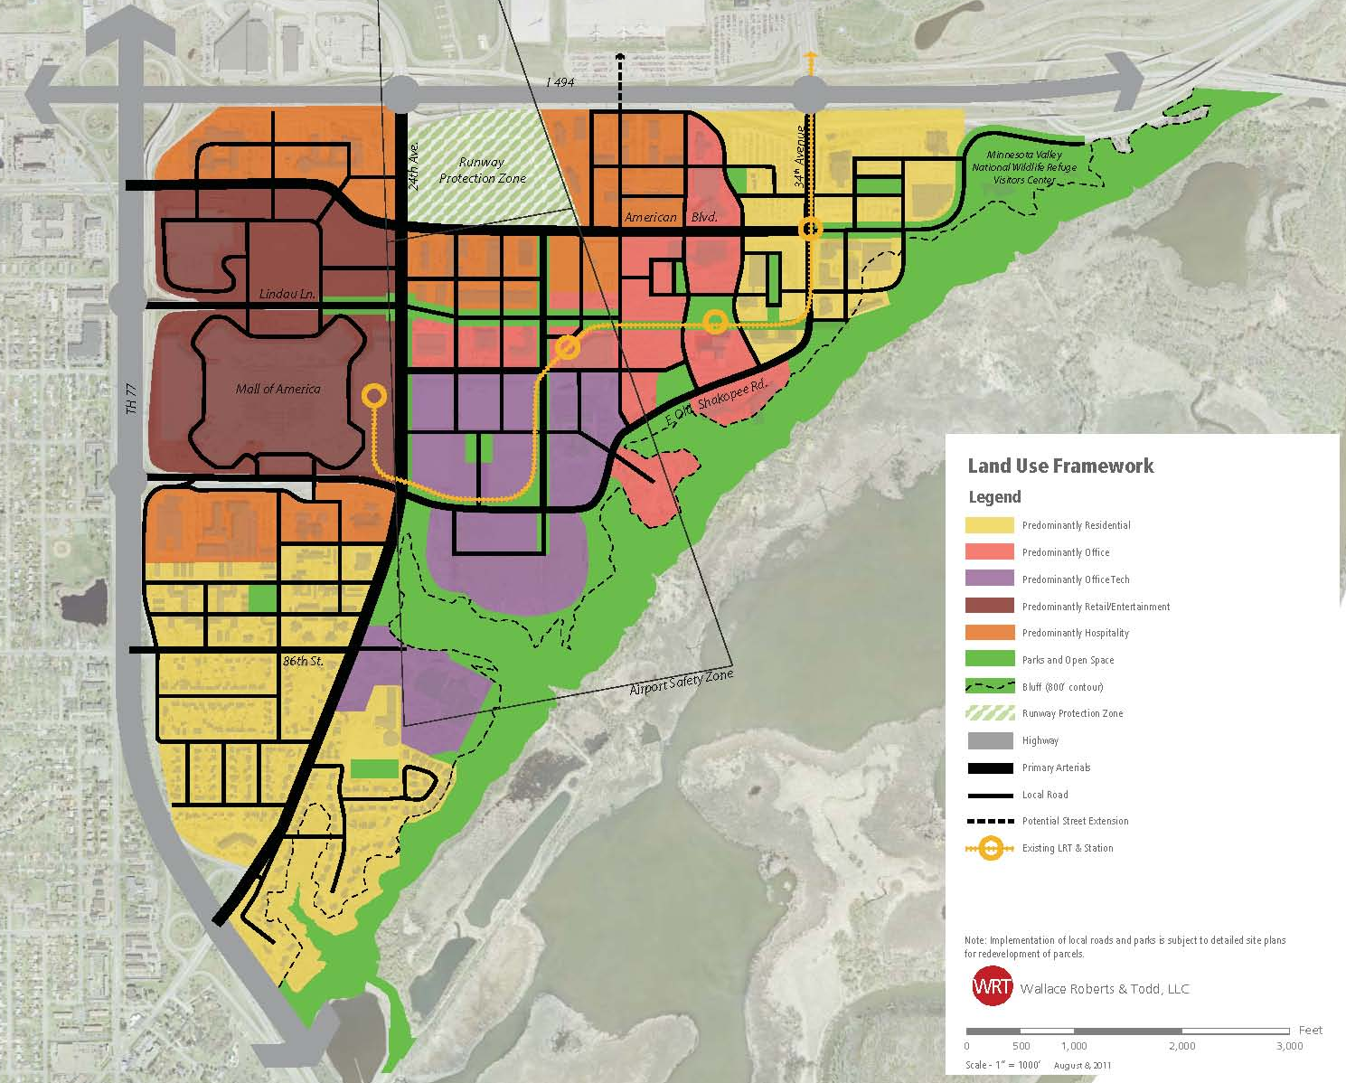
South Loop Land Use Framework Highlights
Mixed use by dominant use themes
New high-density residential, mixed use TOD neighborhood
New Office/Tech land use
Dense, mixed use, walkable, core connecting MOA and BCS

Slide 14
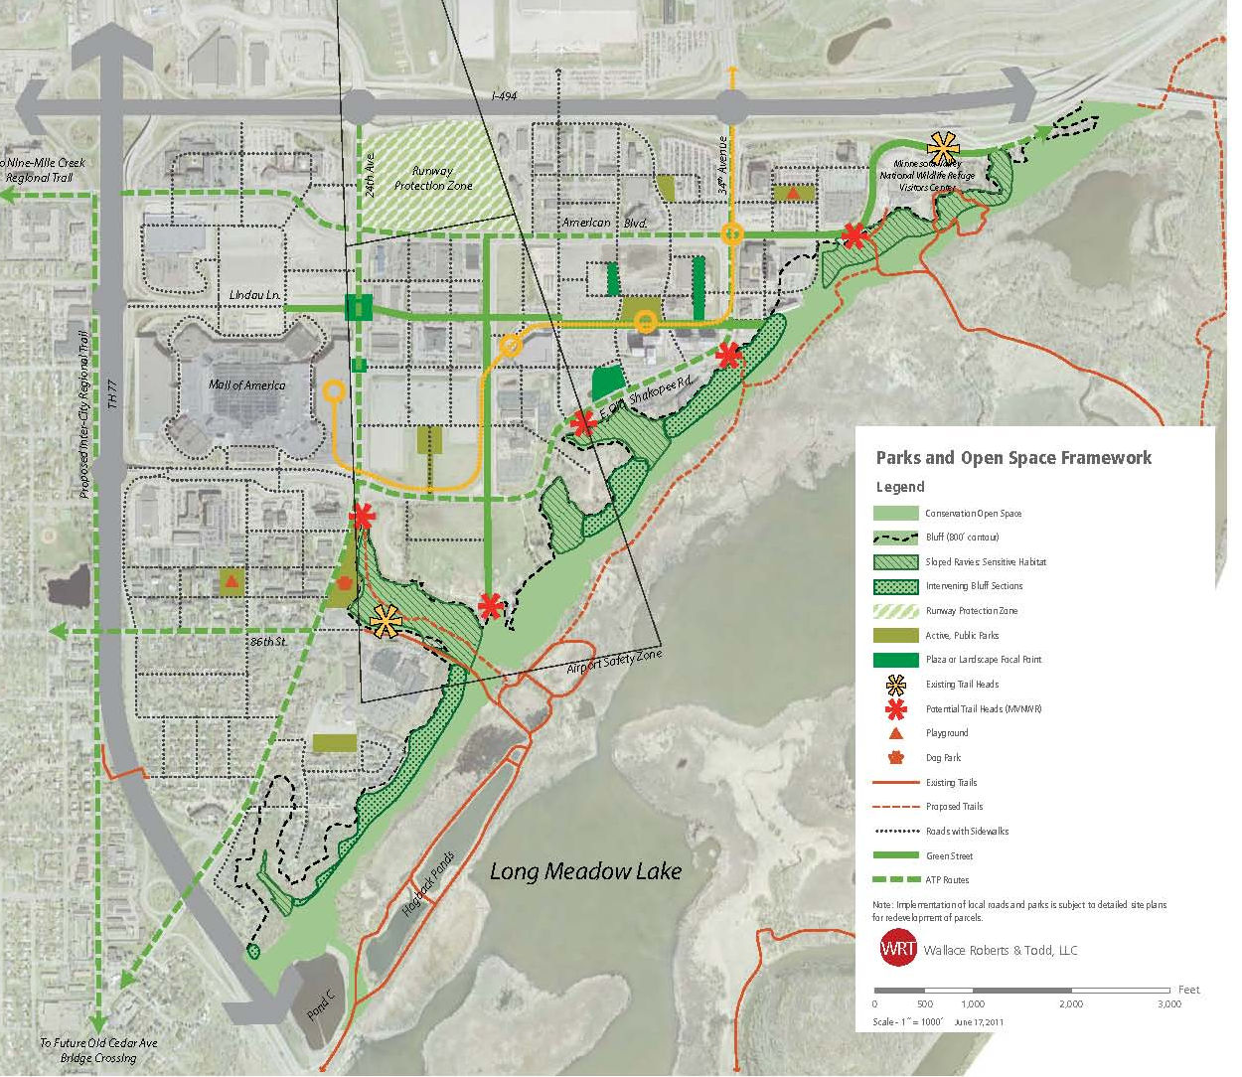
South Loop Parks & Open Space Framework Highlights
Parks and plazas create focal areas
Network of sidewalks and trails
“Greenway” entrance to MVNWR
New park and ravine trail
New trailheads into MVNWR
Notes:
Provide park and open space facilities for new users and existing neighborhood residents including the park and trailhead at East Old Shakopee and 24th Avenue.
Improve access and access facilities to the Minnesota Valley National Wildlife Refuge (MVNWR).
Assure that development adjacent to Bluff Edge area is compatible the natural resource base.
Develop pedestrian and bicycle connectivity within South Loop and to destinations outside of the district.
Protect, preserve and restore natural resources within the bluff edge area.
Focused in existing new residential neighborhoods.

Slide 15
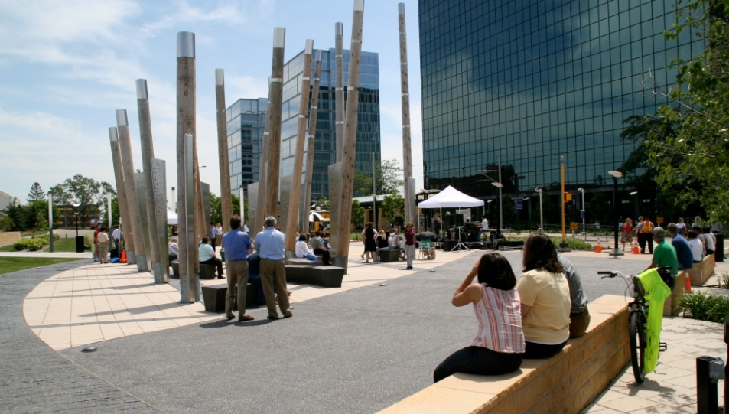
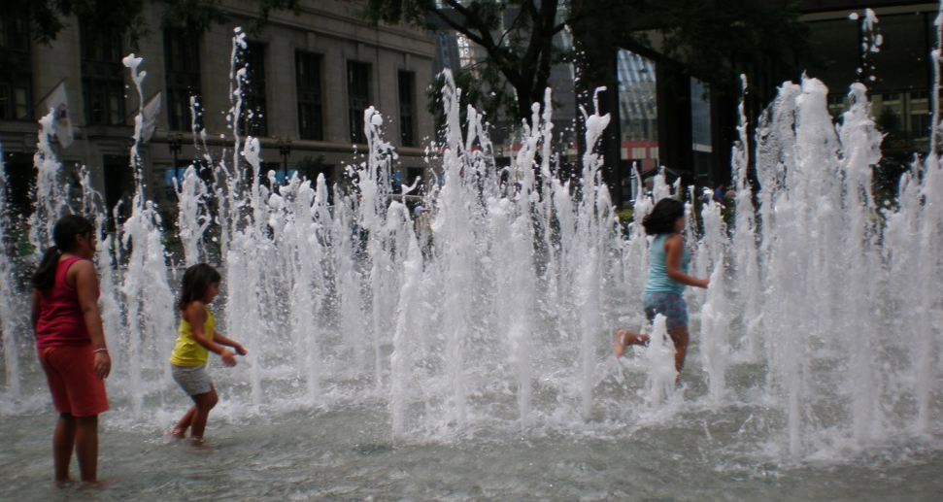
From public art to creative placemaking
  Integrate art and artists into South Loop, including public infrastructure, from the beginning.
  Think holistically, not on piecemeal basis
  Build City and partner (e.g. BTAC) capacity to encourage and foster creative placemaking in South Loop for years to come

Slide 16
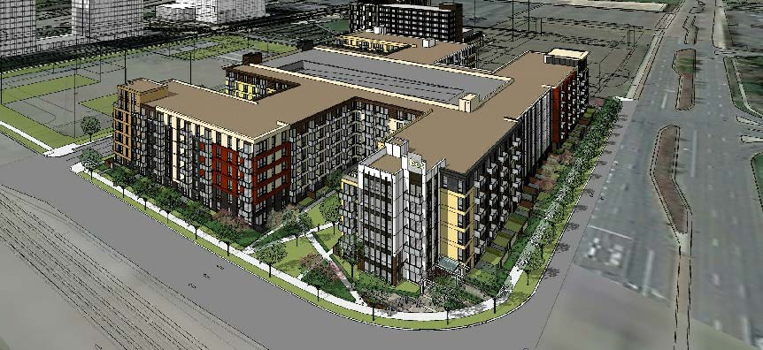
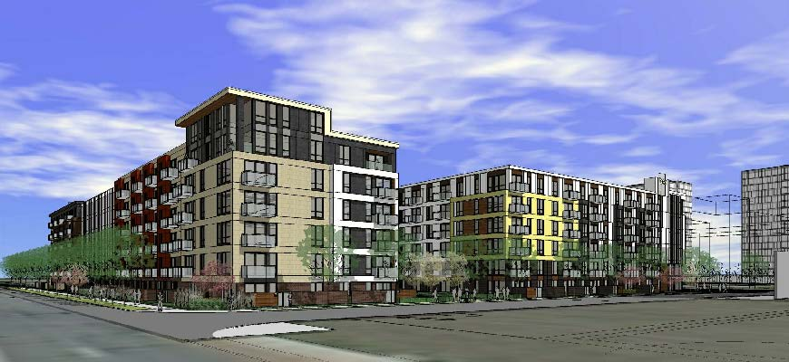
Pending Development
BCS – Residential (Lennar)
Notes:
840 units total (2 phases). Phase 1 = 420 units, 6 stories. Spring start?

Slide 17
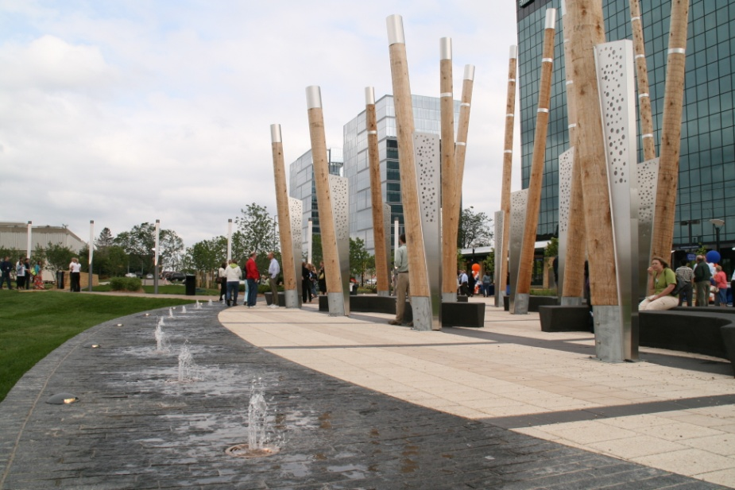
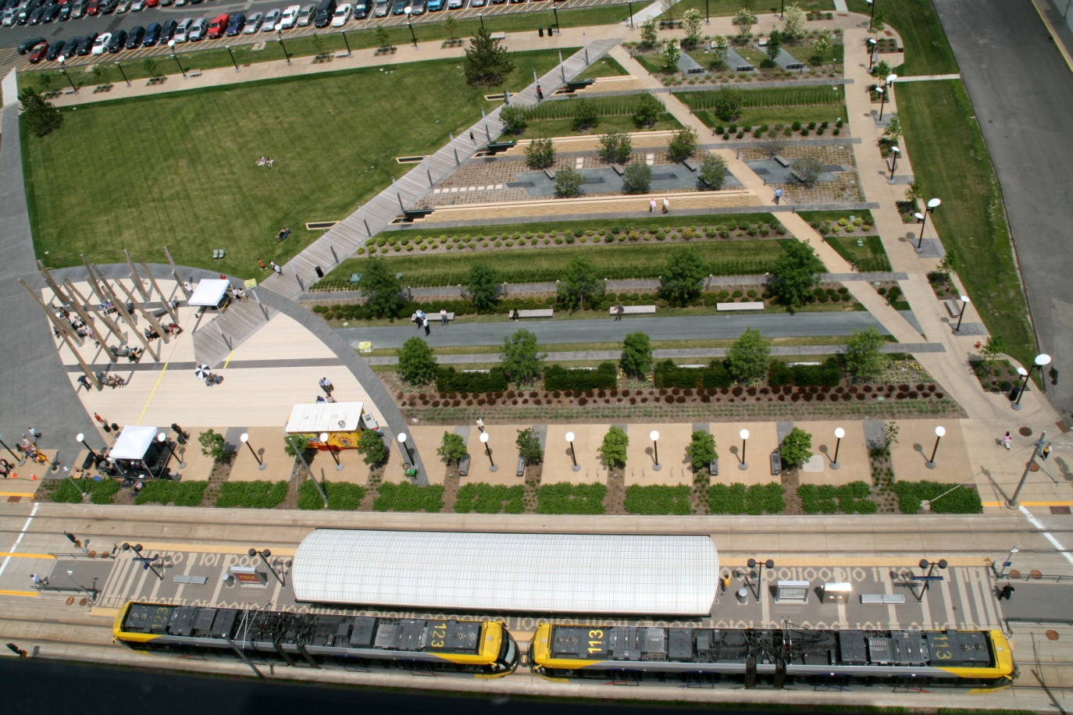

BCS Central Park

Slide 18
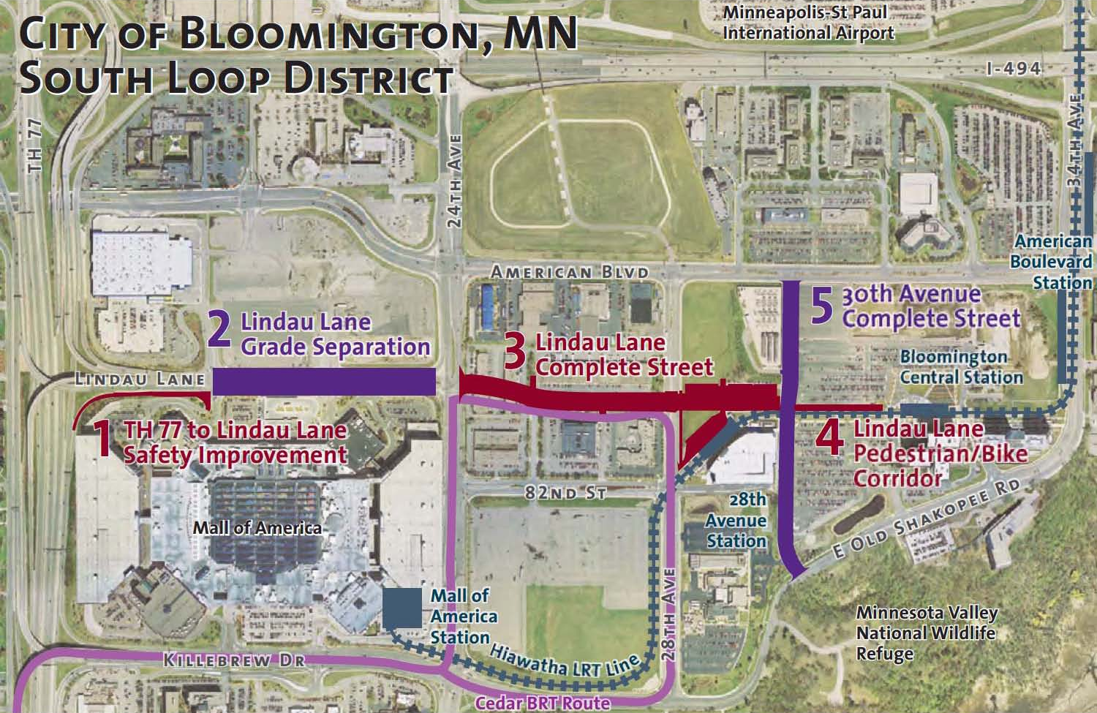
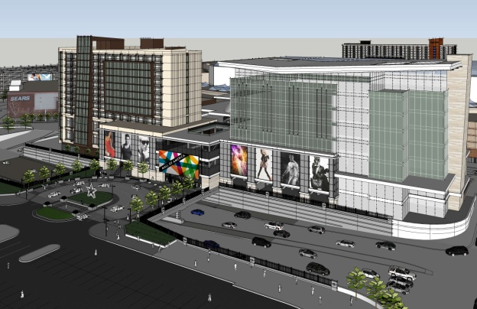
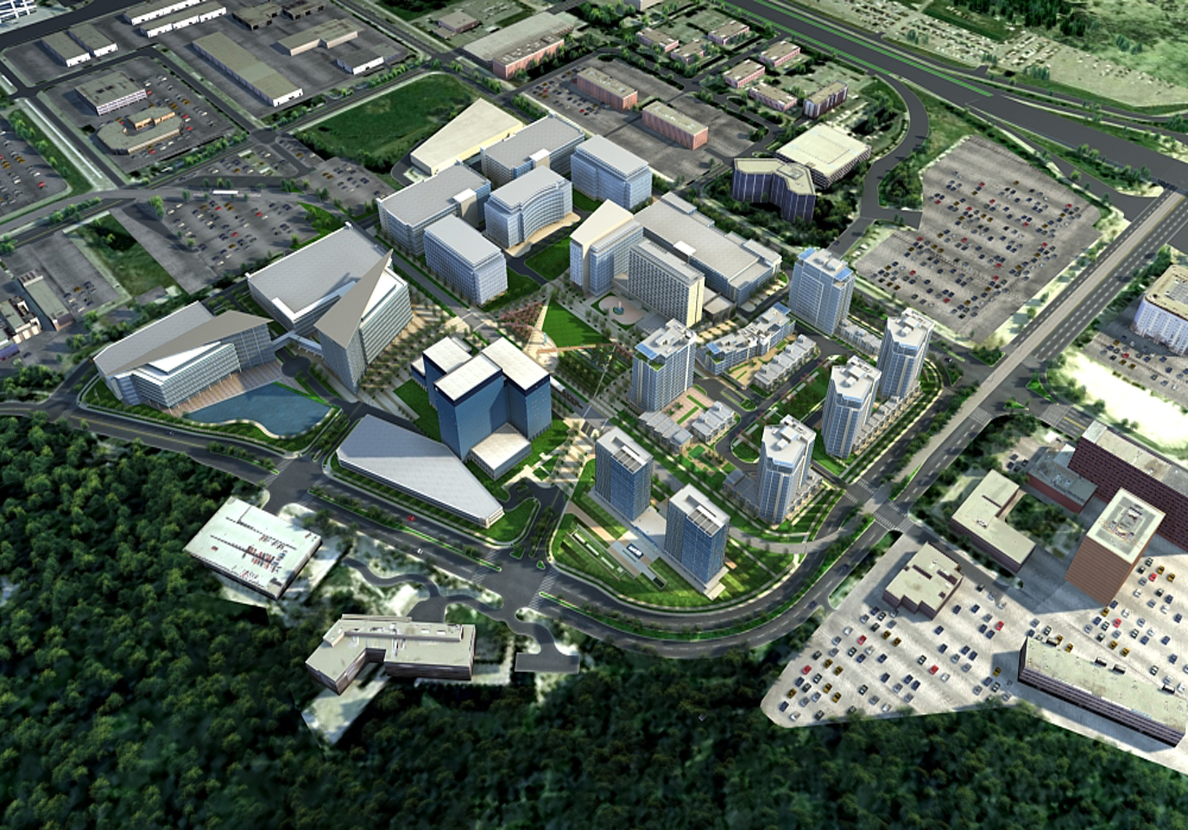
Lindau Lane
Mall of America
40+ M visitors per year
Additional 5+ MSF
Bloomington Central Station
$1 billion, mixed-use TOD
Lindau Lane

