Slide 1
LRT and TOD in BP
Kim Berggren, Director of Community Development
Cindy Sherman, Planning Director
Jen Jordan, Senior Project Manager (LRT)
Met Council TOD Workshop, Jan 27, 2017

Slide 2
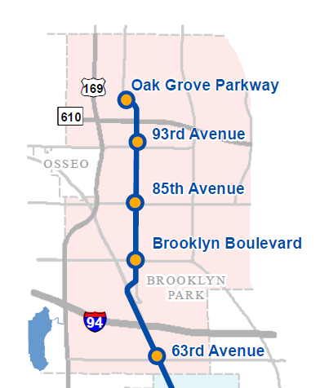
METRO Blue Line Light Rail Transit (LRT) Planning
Proposed Schedule
2014–2016 Development
2016 Environmental Review
2017 Engineering and Seek State Funding Approval
2018 Funding Agreements
2018–2020 Construction
2021 Opening
Website: BlueLineExt.org
Email: BlueLineExt@metrotransit.org
Twitter: @BlueLineExt

Slide 3
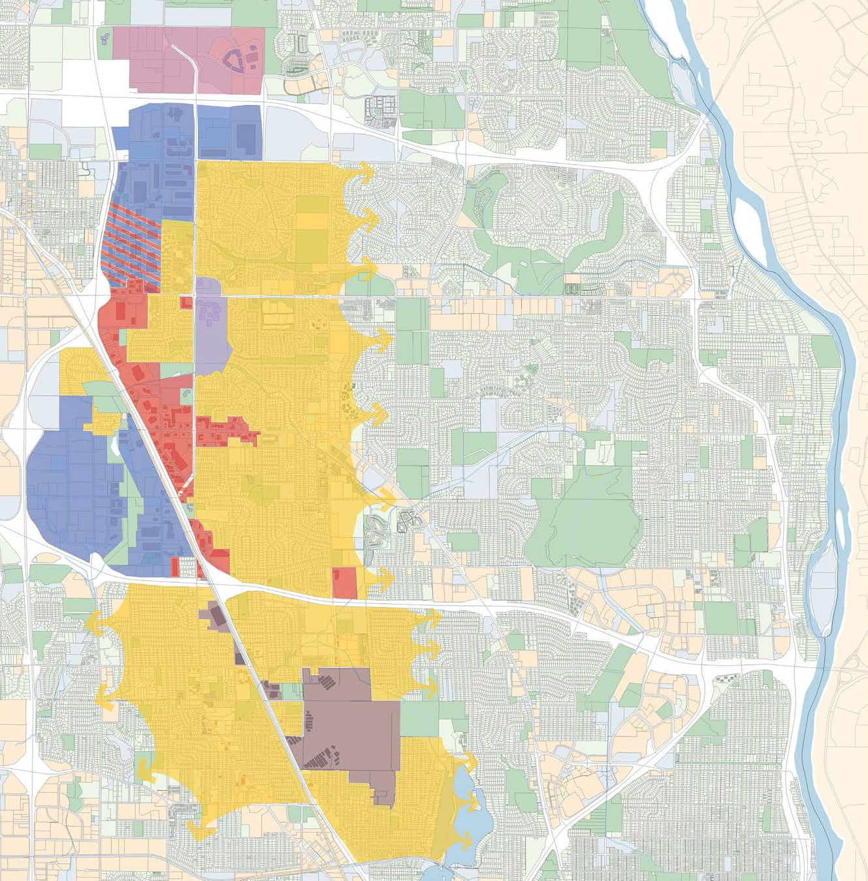

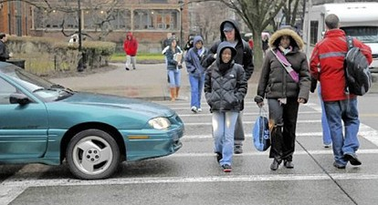
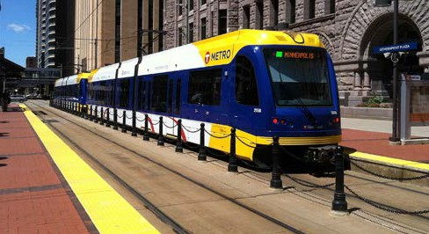
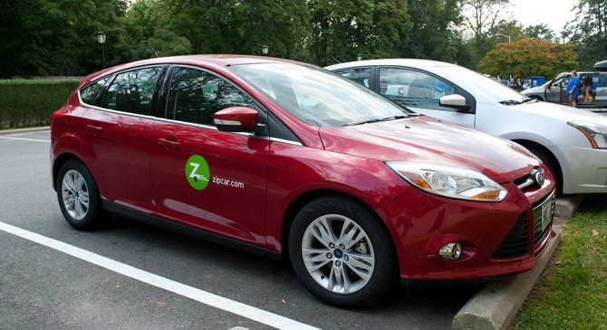

Five Stations in Brooklyn Park
Station Area Planning Focus
Vehicles
Pedestrians
Bikes
Shared-use Mobility
Oak Grove – Mixed-Use
93rd Ave – Employment
85th Ave – Institutional
Brooklyn Blvd – Retail
63rd Ave – Neighborhood
Station Area Planning
Brooklyn Park, Minnesota
Notes:
5 stations
Different land uses at each station

Slide 4
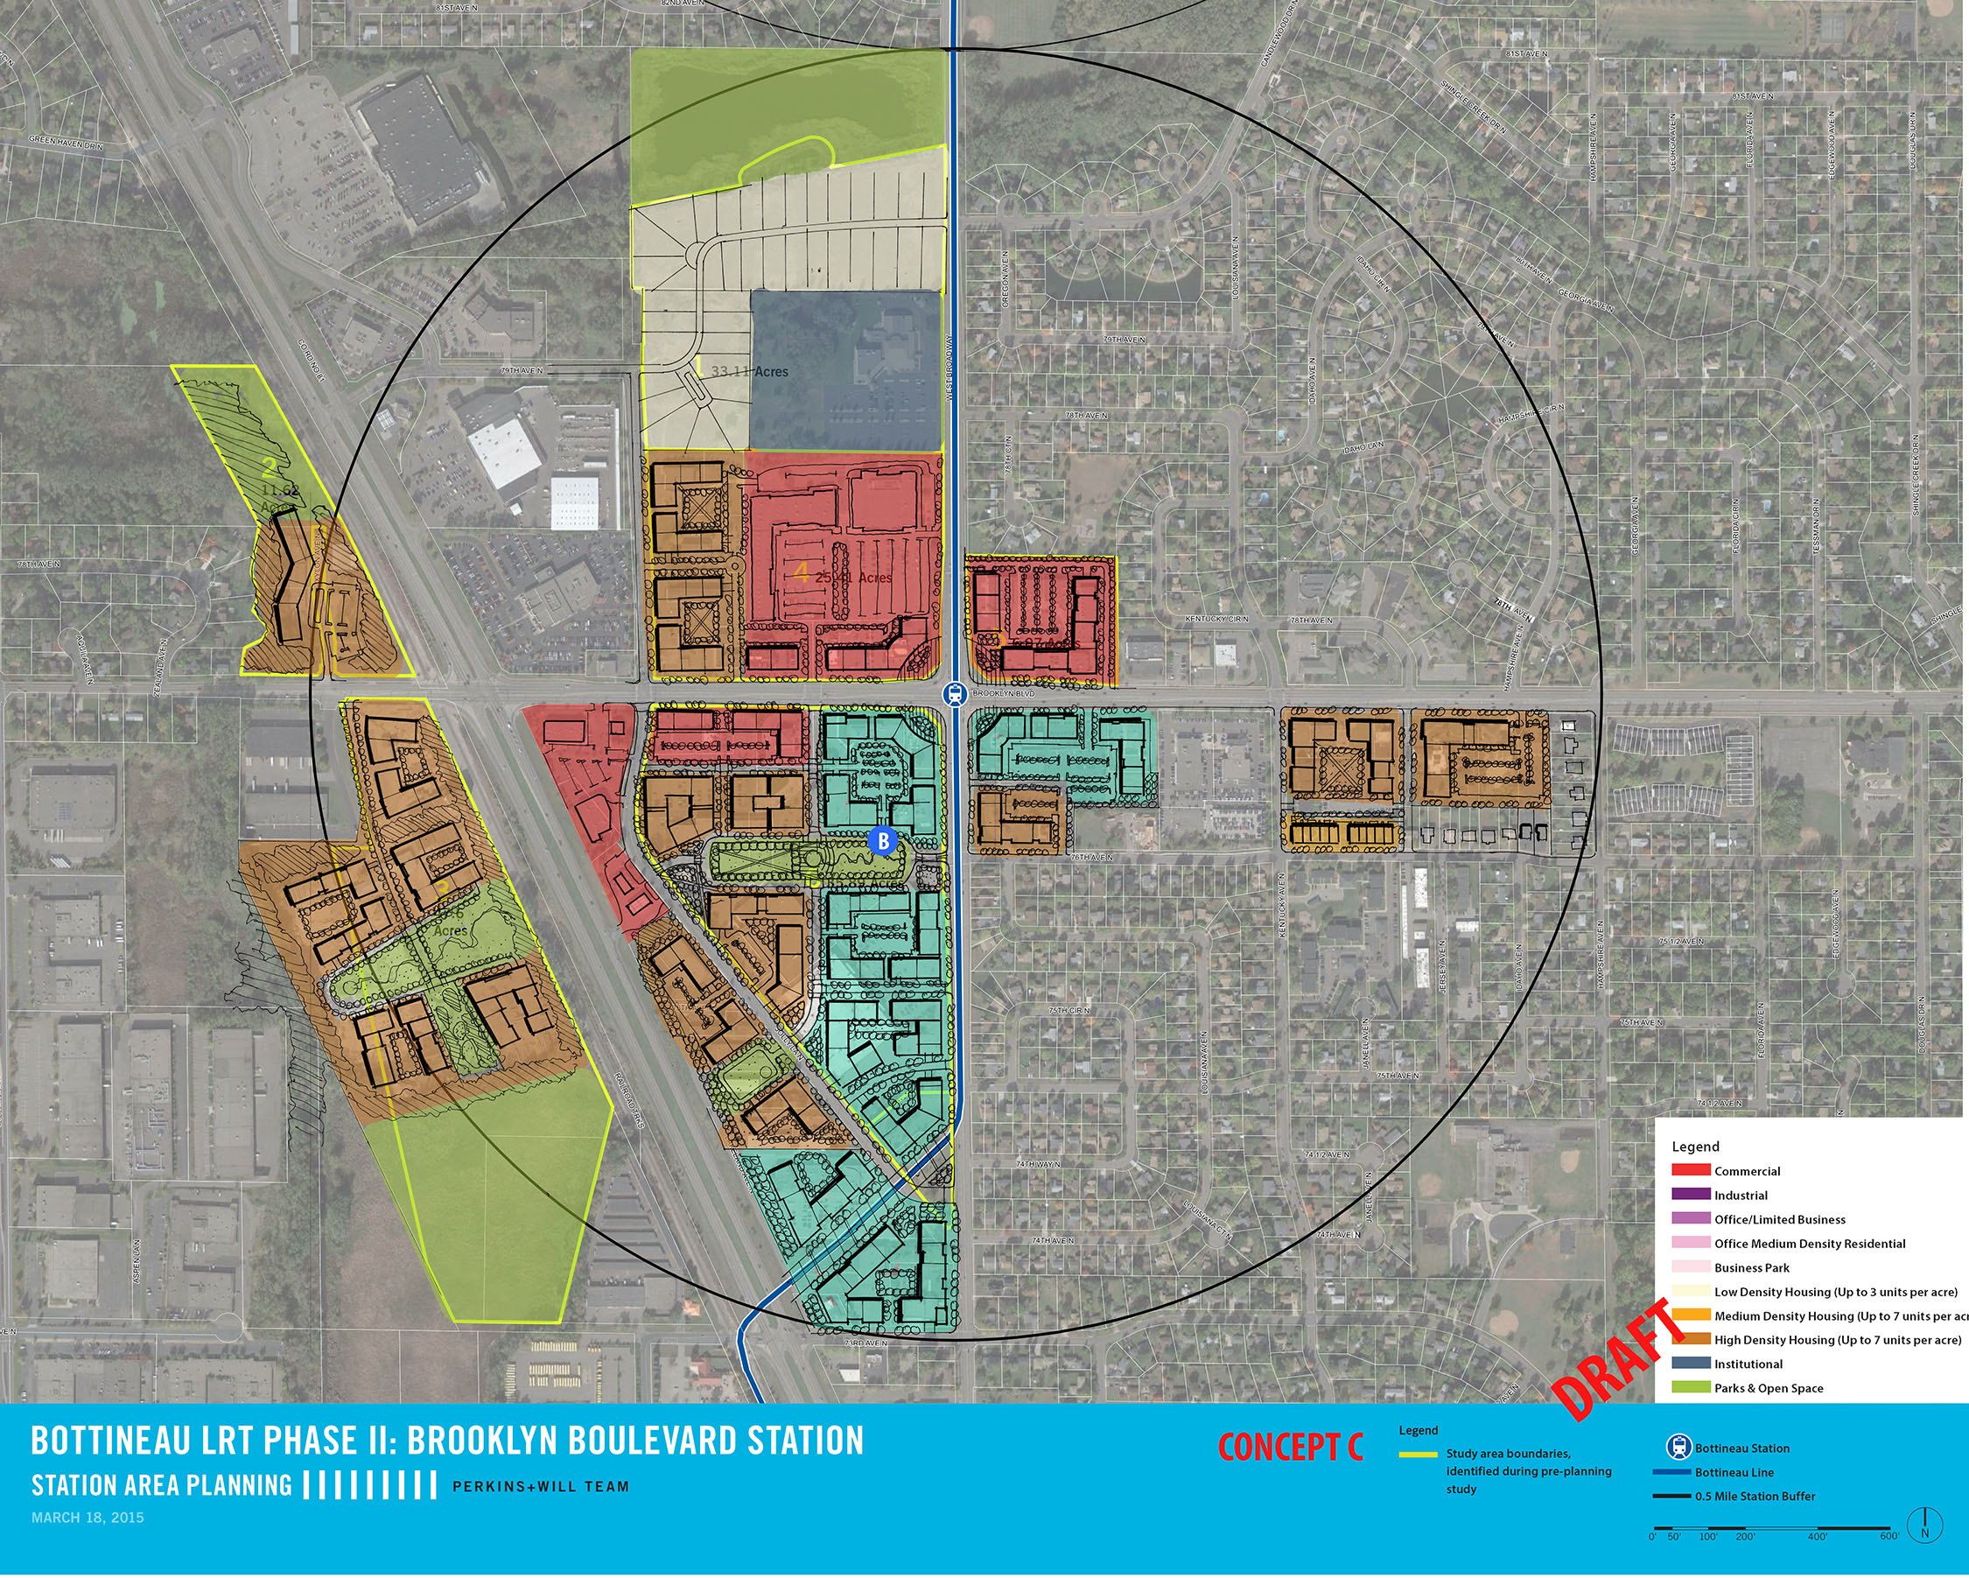
Early work was missing Context
Community awareness
Local politics
Property ownership and market
Notes:
When we started our station area plans back in 2014 – focus was very technical. Here is an example of a graphic that was produced.
Problem was – no attention to context
Reality of where community was – still becoming aware of LRT project
Reality of politics – split council on whether or not to support LRT
Market reality – showed how land uses could fit, but not tied to what currently existed – current property lines and the fact that the commercial properties are doing well here and are unlikely to redevelopment in the short or mid term

Slide 5
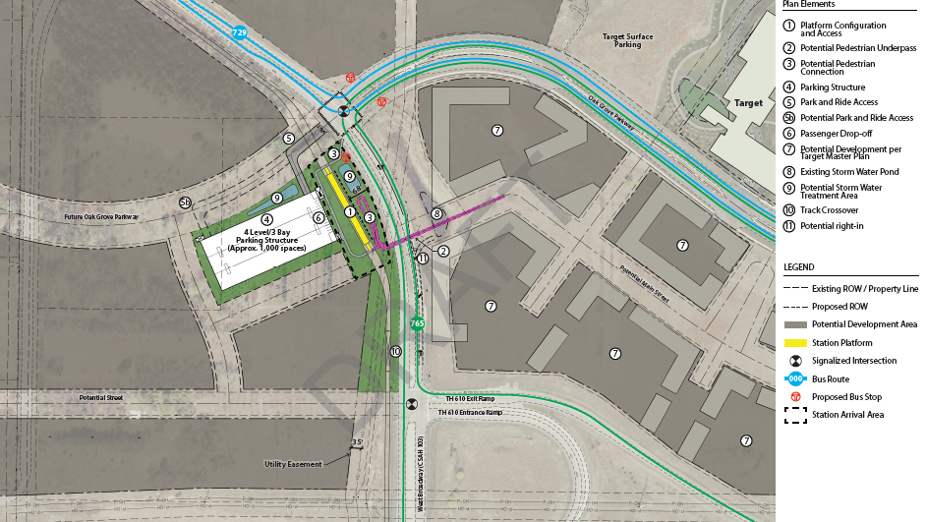
Train Project Planning – Blueline Project Office (BPO)
Notes:
May 6 image – designed by engineers to meet goals of the train.
-- Major concerns about what this would do to the development potential of the area.

Slide 6
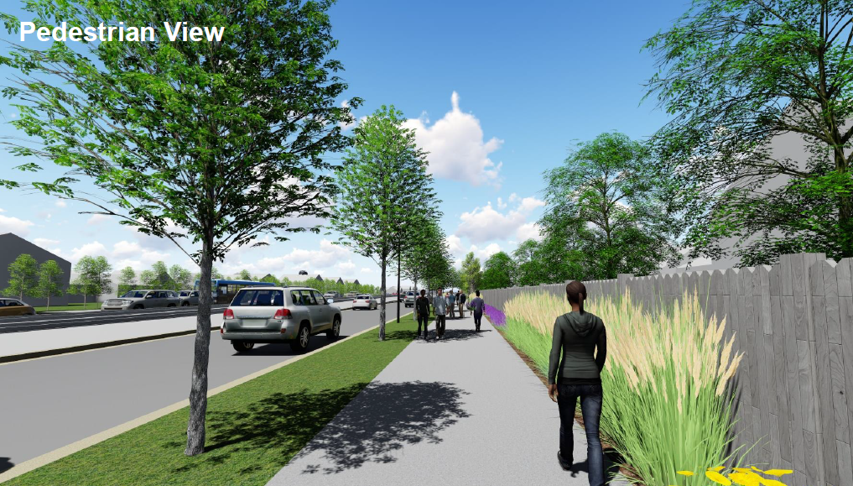
West Broadway Vision

Slide 7
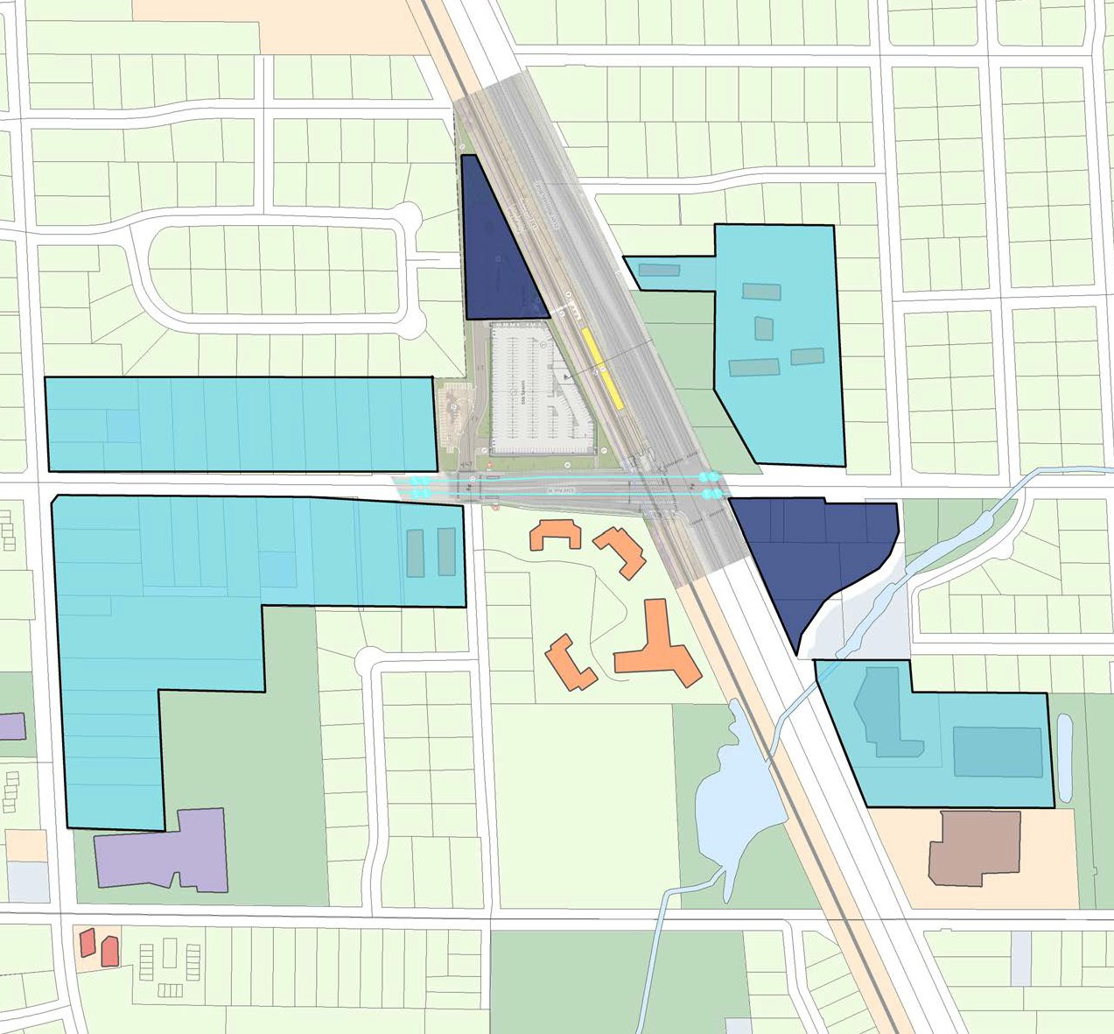
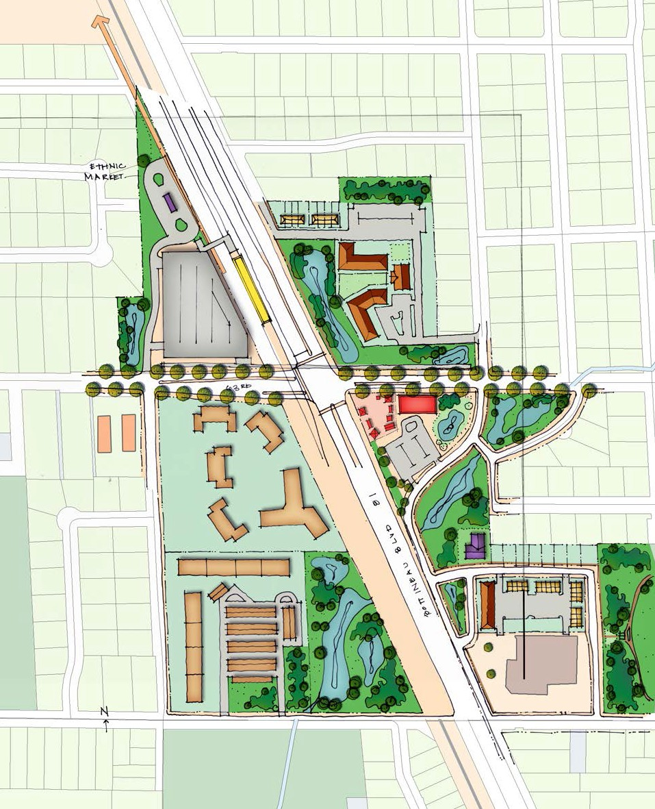
63rd Avenue N. – Opportunity Areas
Short-Term (5-15 years)
Long-Term (15-25 years)

Slide 8
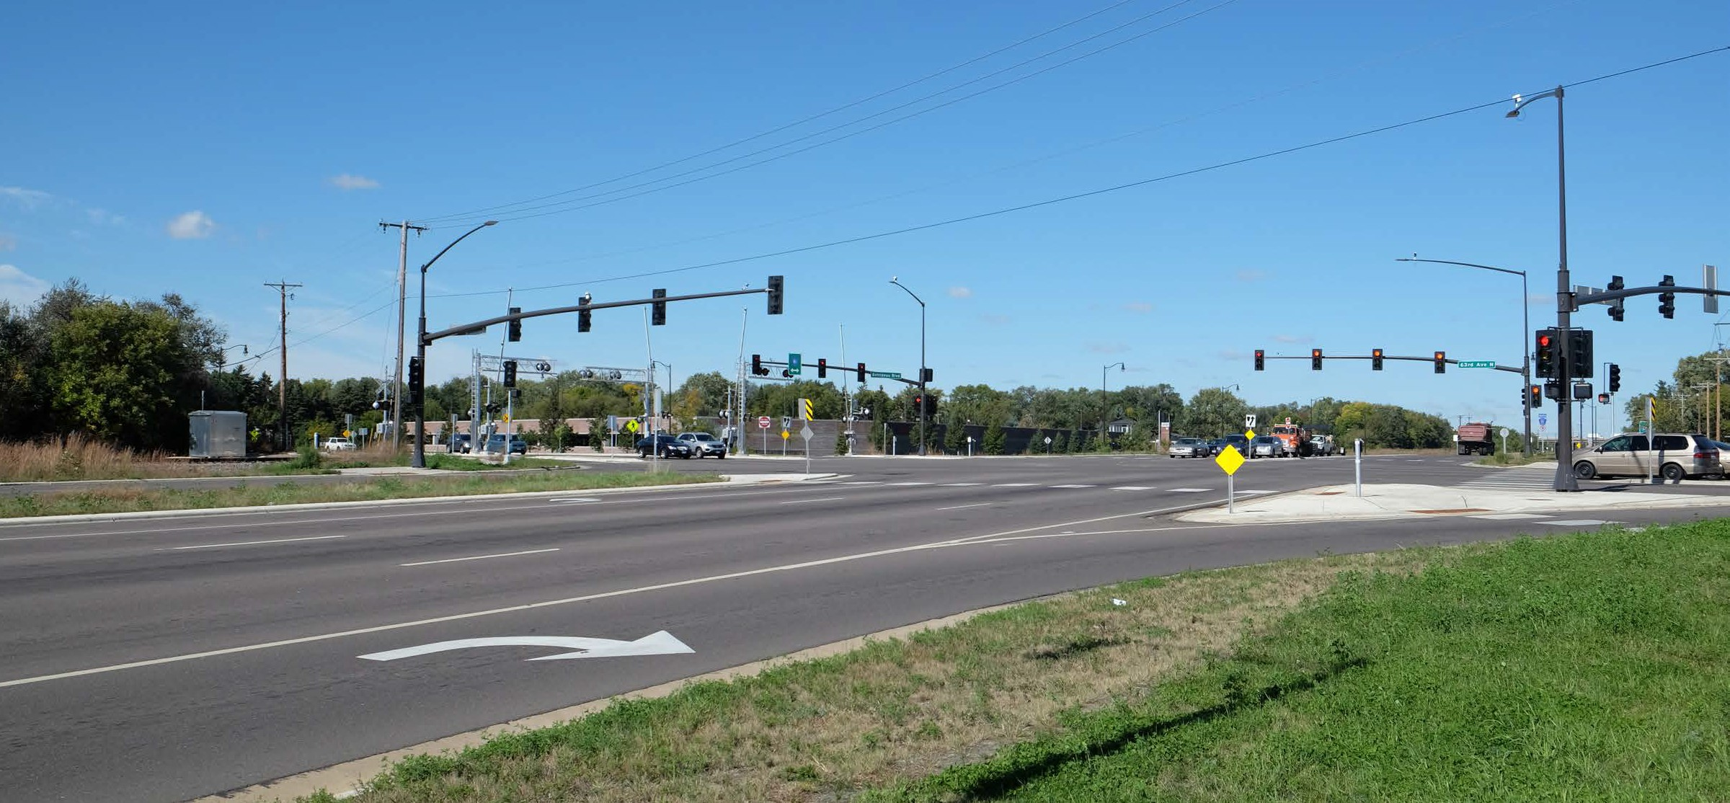
63rd Avenue N. – Neighborhood

Slide 9
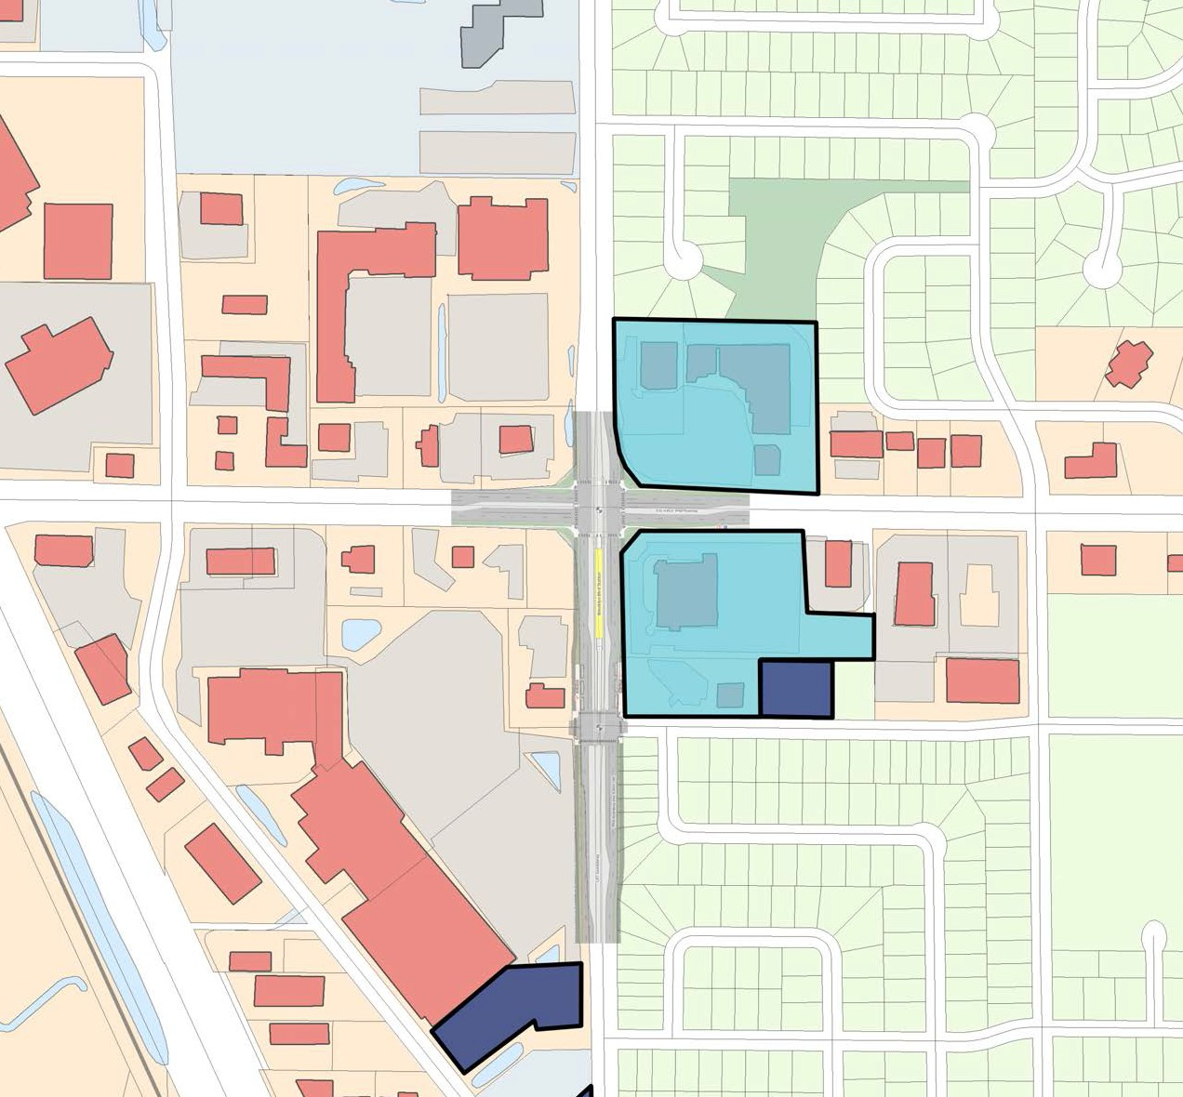
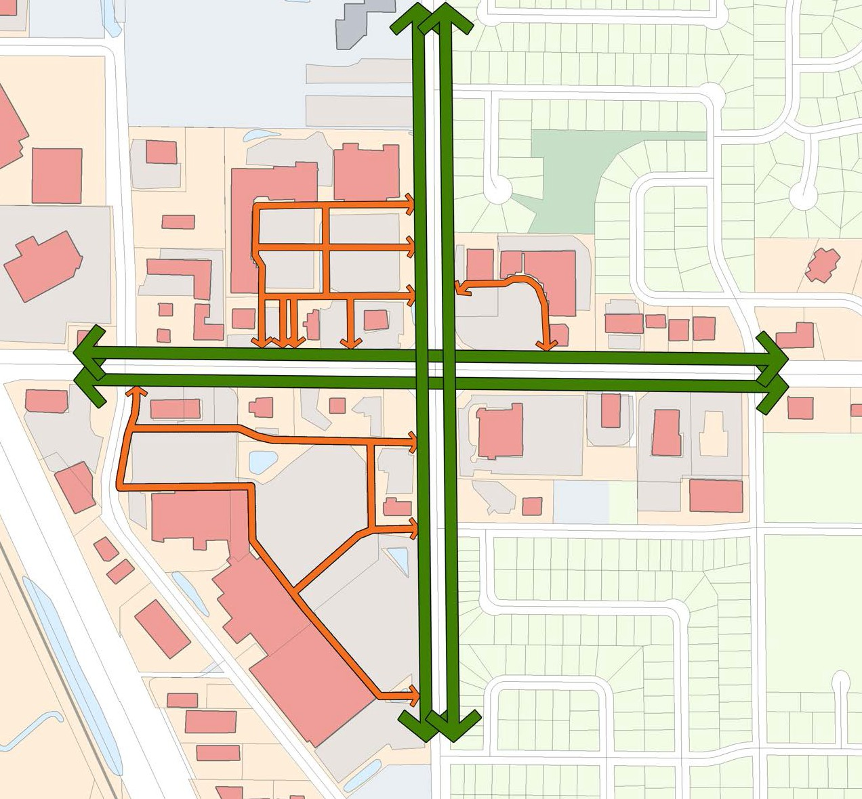
Brooklyn Boulevard – Opportunity Areas
79th Ave. N.
Kentucky Ave. N.
Brooklyn Boulevard
W. Brooklyn Ave.
Kentucky Ave. N.
Jolly Lane
Target
Short-Term (5-15 years)
Long-Term (15-25 years)
75th Ave. N.

Slide 10
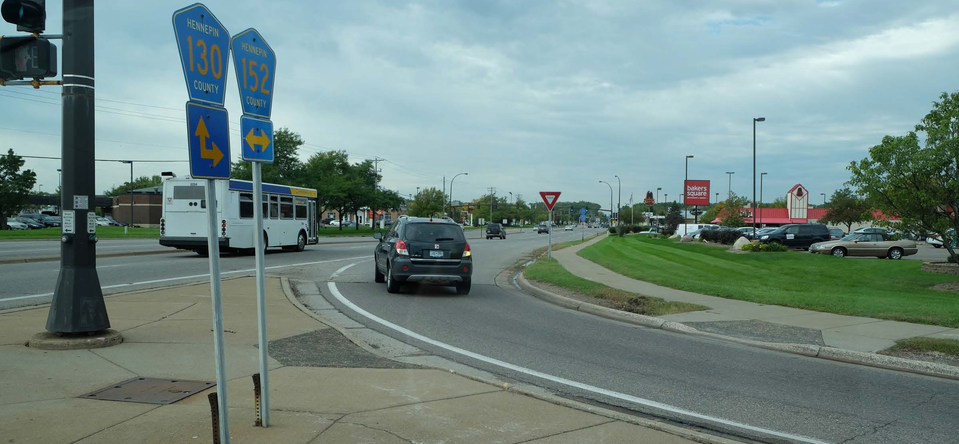
Brooklyn Boulevard – Commercial Center

Slide 11
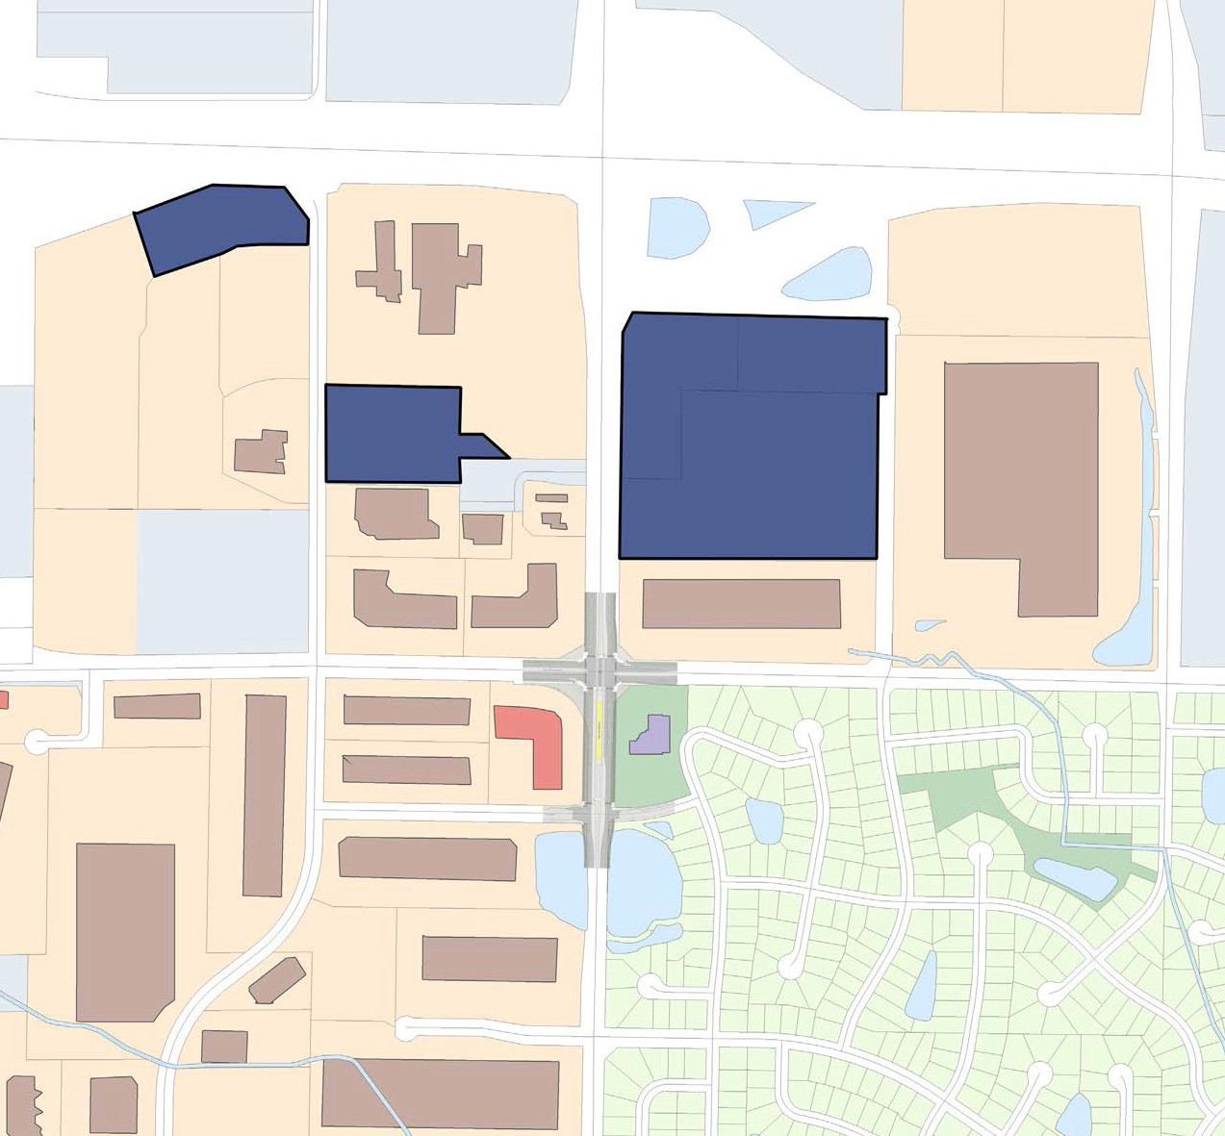
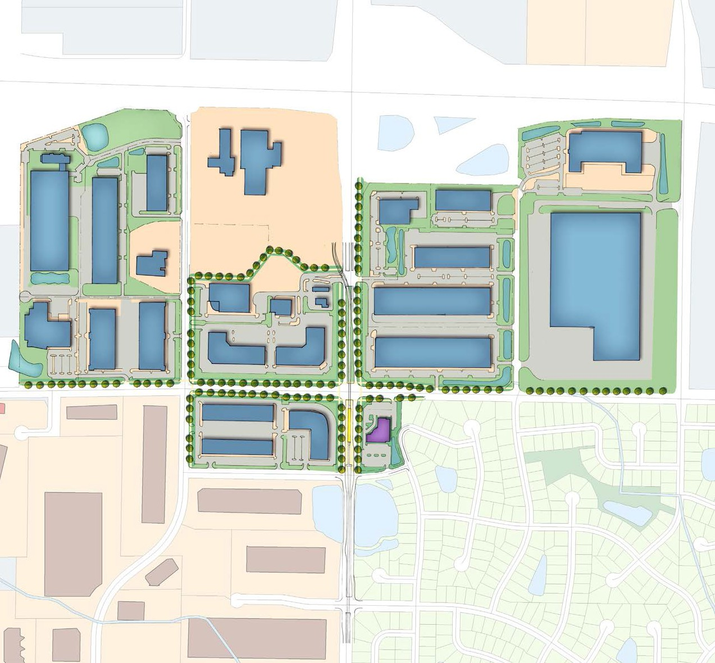
93rd Avenue N. – Opportunity Areas
Short-Term (5-15 years)
Long-Term (15-25 years)
Notes:
How many jobs?

Slide 12
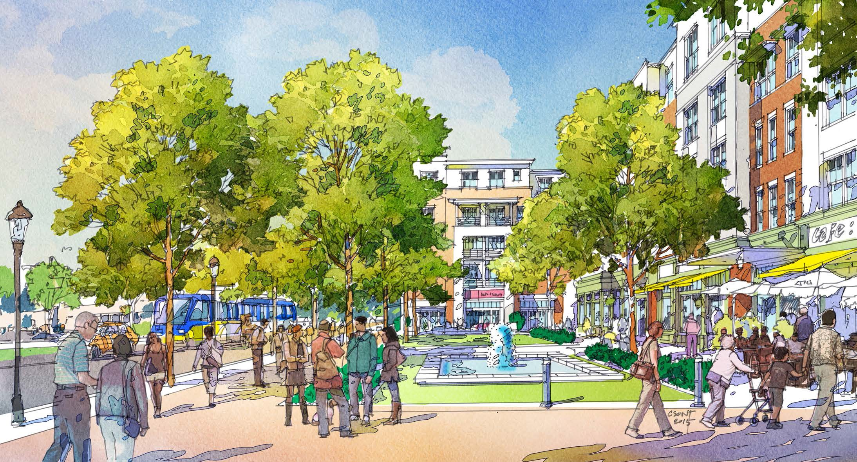
Brooklyn Boulevard – Creating Places for People

Slide 13
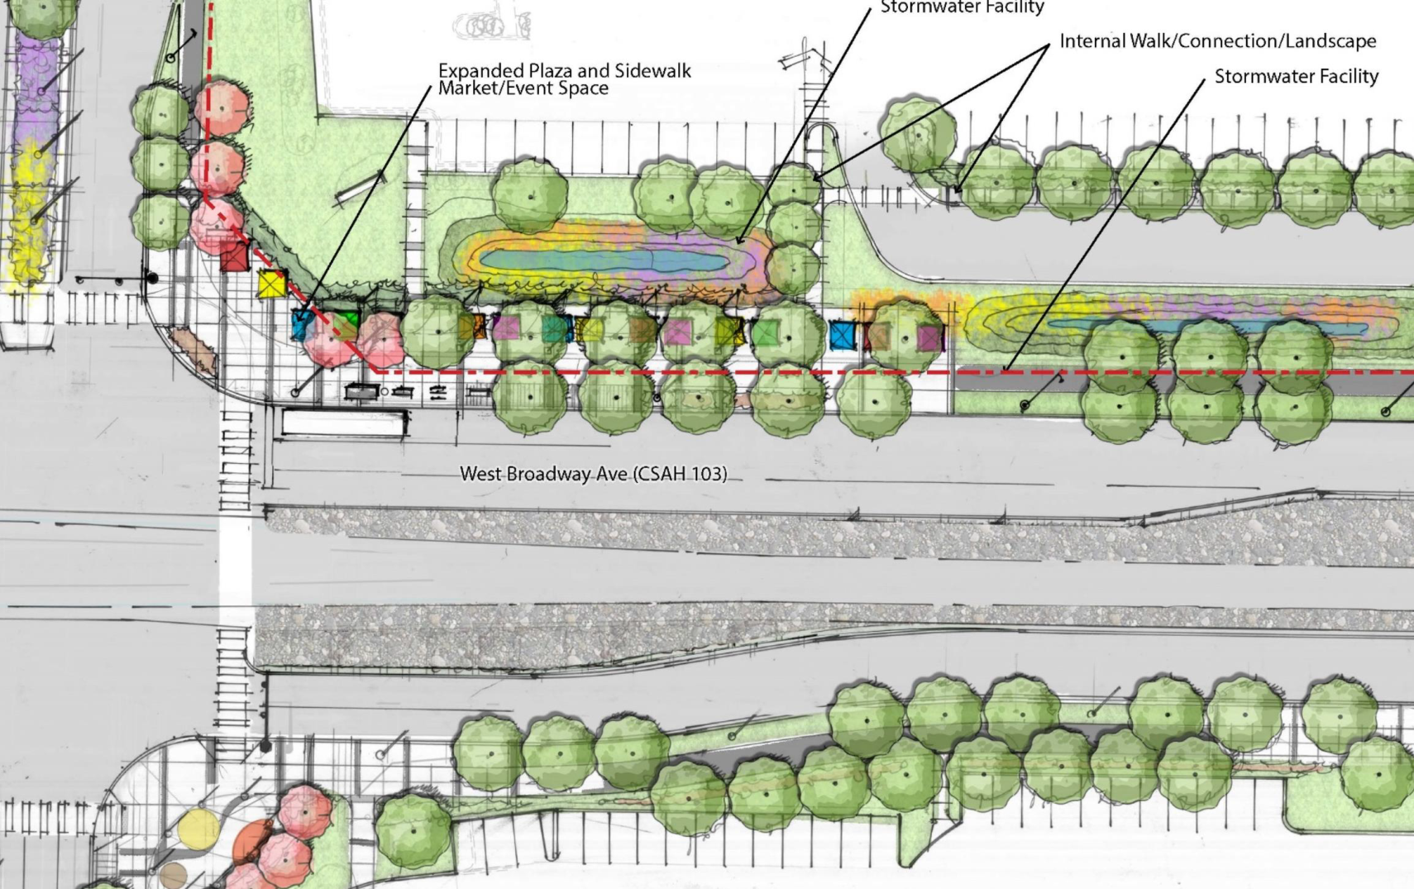
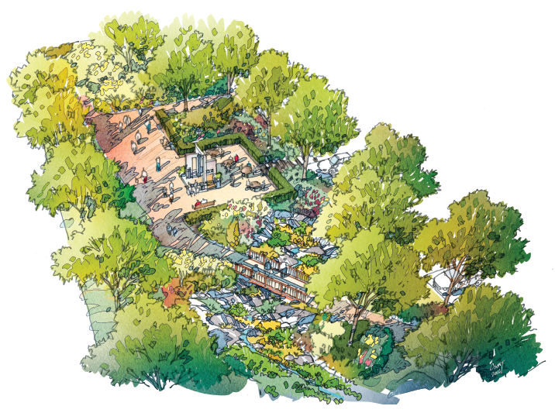
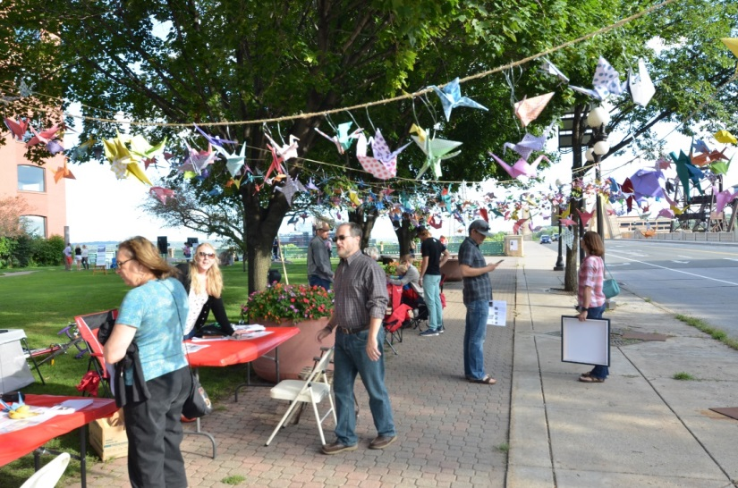
Notes:
Station Area plans opened the door and set the principles that we are now using for the next level of design concepts.
On Oct 8 we were able to partner with the local grocery store – Dragon Star – enhance weekend farmers market. Hope to continue to support early placemaking here that could eventually become a formalized place.
This is a plaza design idea for the NW corner at WB and BB.

Slide 14
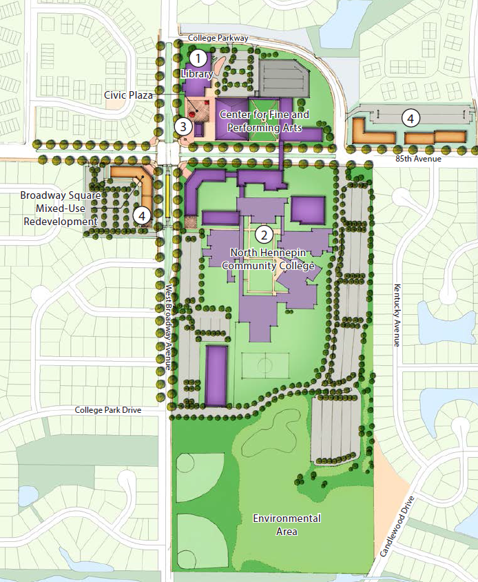
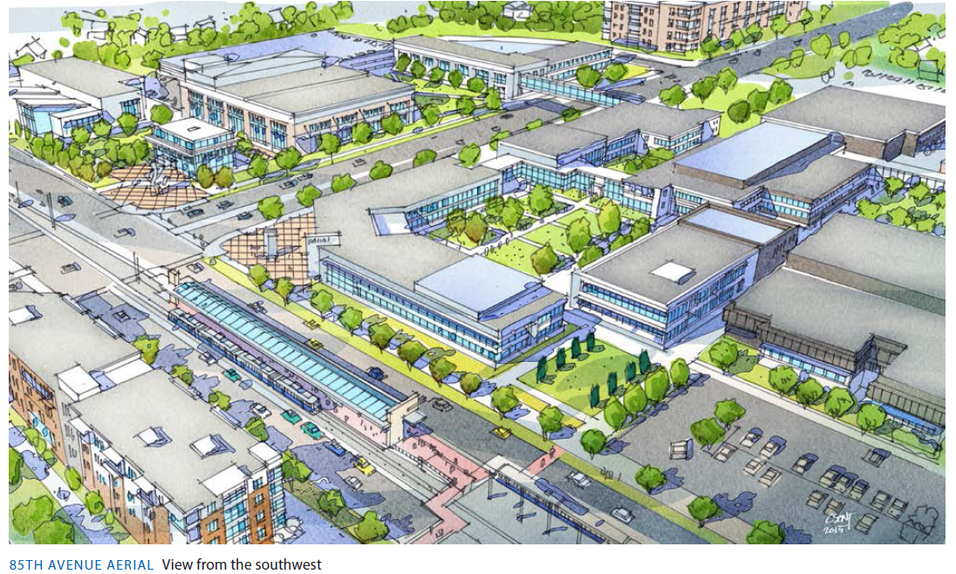
85th Avenue N.
North Hennepin Community College
Performing Arts Center
Shared parking ramp and campus courtyard
Fine Arts/
Classroom space
Shared public plaza with flex building
LRT Platform

Slide 15
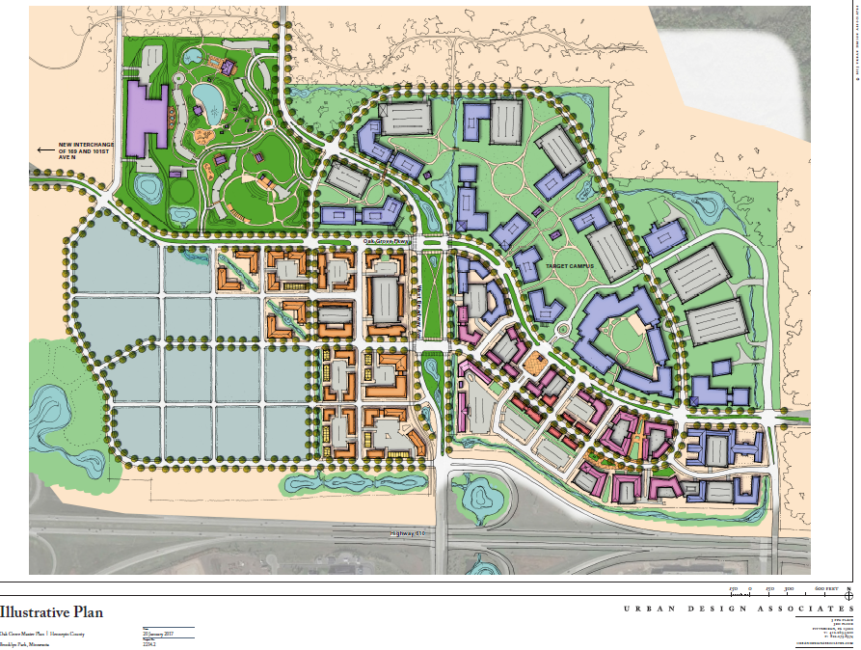
Oak Grove
Station Area

Slide 16
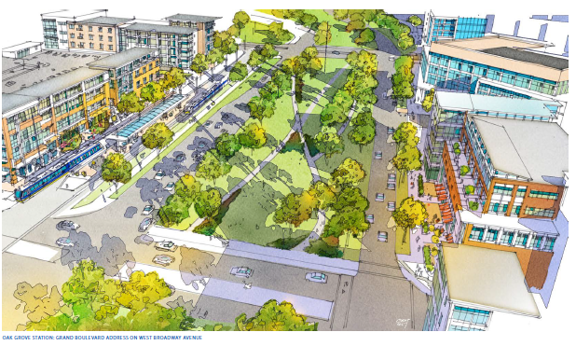
Future Vision for Oak Grove

Slide 17
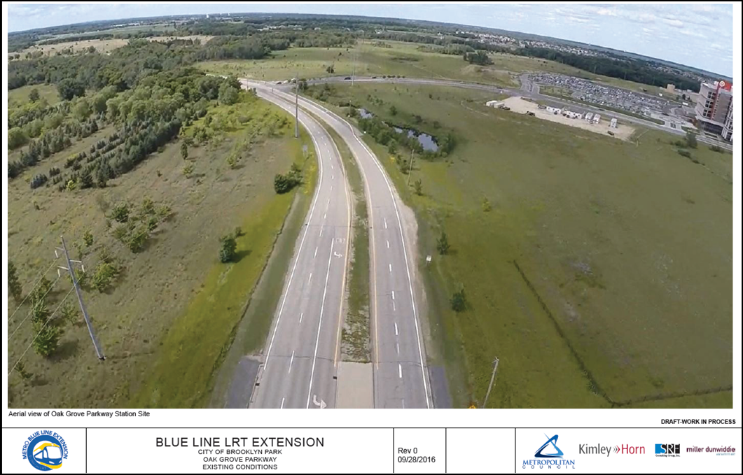
Oak Grove Station Area Today

Slide 18
Oak Grove Station– Integrated Park & Ride Development

