Slide 1
Transit Basics
Workshop Series for Comprehensive Plan Updates
Transit Oriented Development in Your Comprehensive Plan
January 26, 2017

Slide 2
Objectives
Regional Policy & Resources
Local TOD Planning & Practice
Comp Plan

Slide 3
What could TOD be without transit?

Slide 4
Regional Panel Presentation
Mike Larson, Senior Planner
Local Planning Assistance
Kathryn Hansen, Senior Project Manager
TOD Office
Erin Heelan, Senior Planner
Livable Communities Program

Slide 5
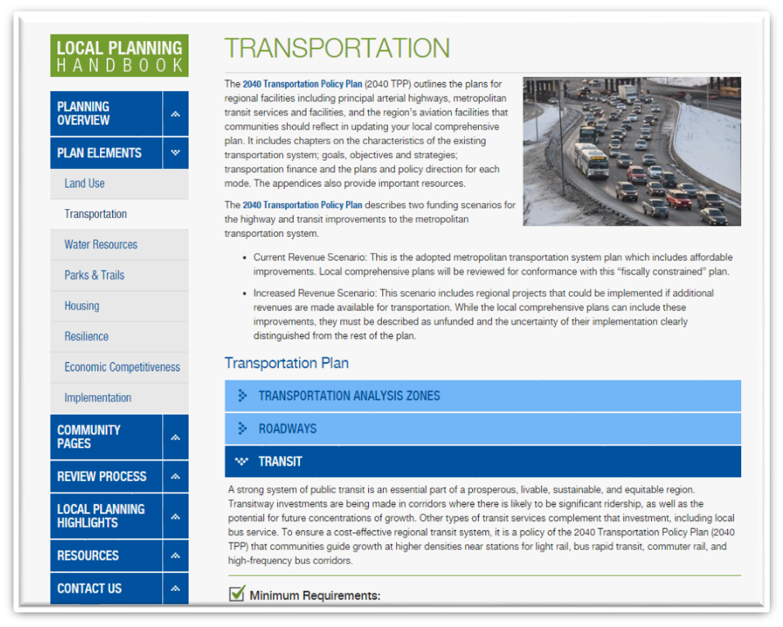
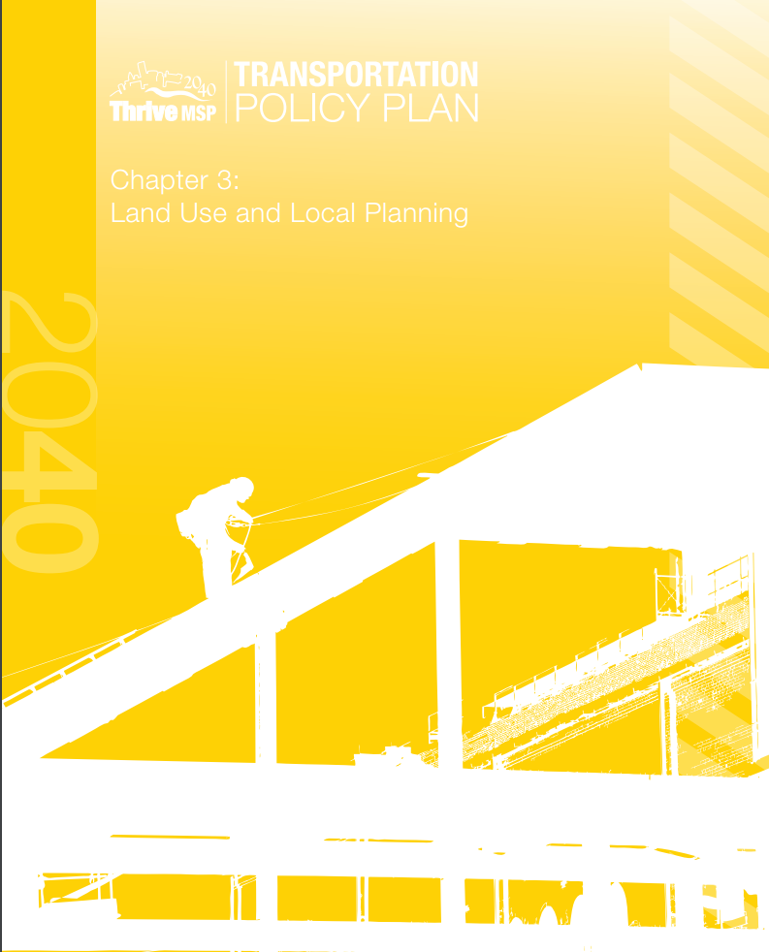
Local Planning Handbook
Notes:
Although all elements of your comp plan are applicable to TOD, the region has new policy expectations around transit investments, which are integrated into the Local Planning Handbook. If you are working on station area planning, it is important that you familiarize yourself, in particular, with Chapter 3 of the Transportation Policy Plan, which addresses Land Use and Local Planning.
In the interest of promoting planning integration and collaboration, we encourage all planners working on the comp plan to review all sections of the Local Planning Handbook. I encourage you to pay particular attention to the Transit section under the Transportation Plan Element. Please review this if you haven’t already done so. It’s relevant to all communities in the region, not just those with dedicated transitways.

Slide 6
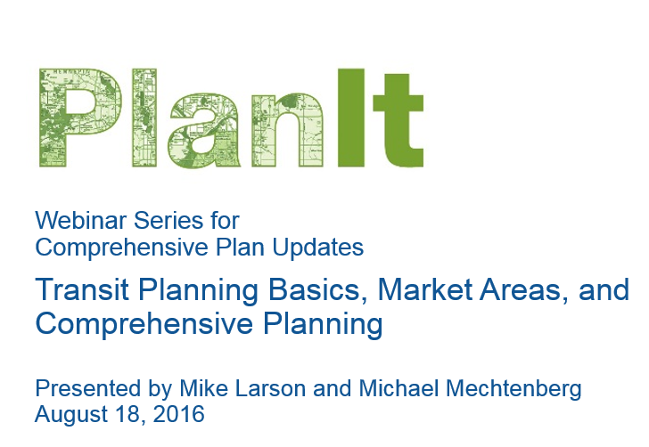
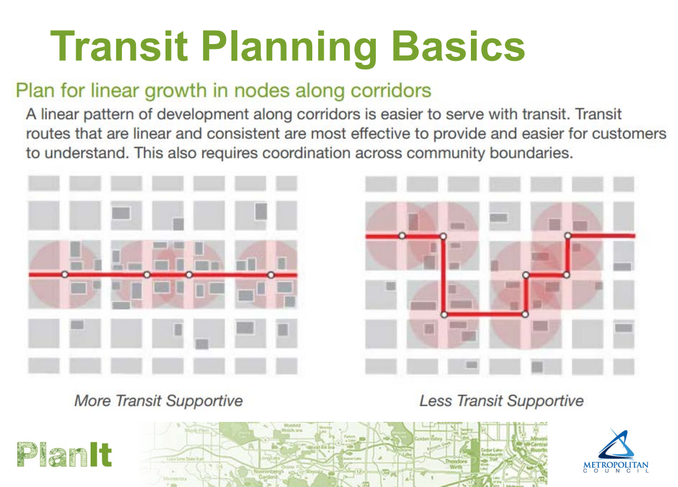
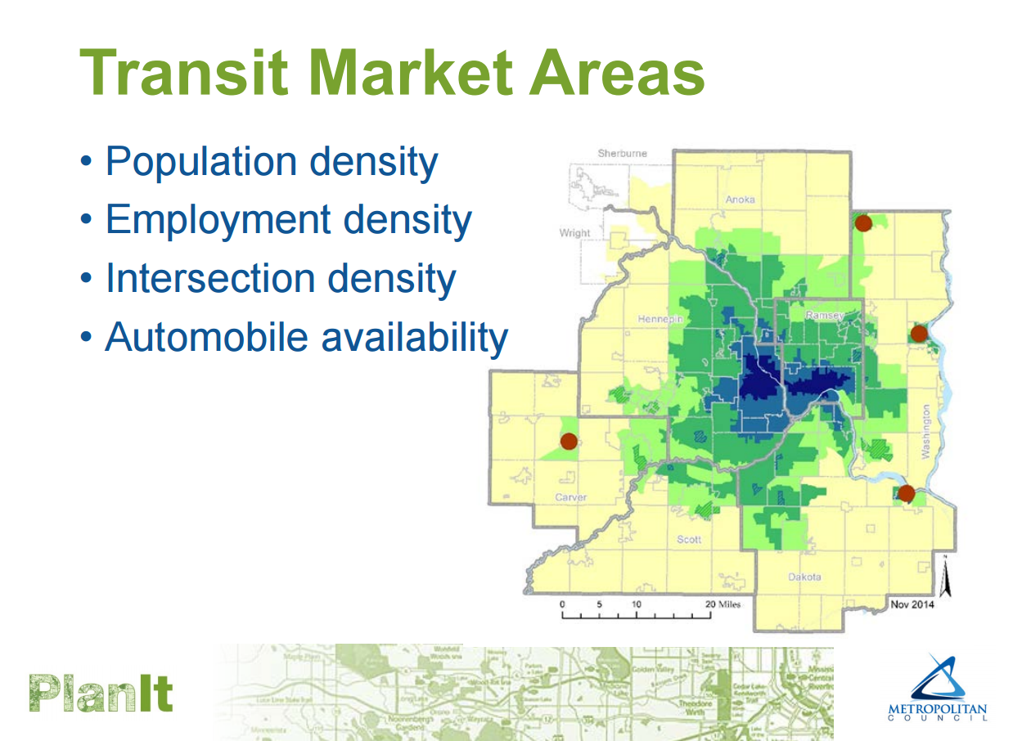
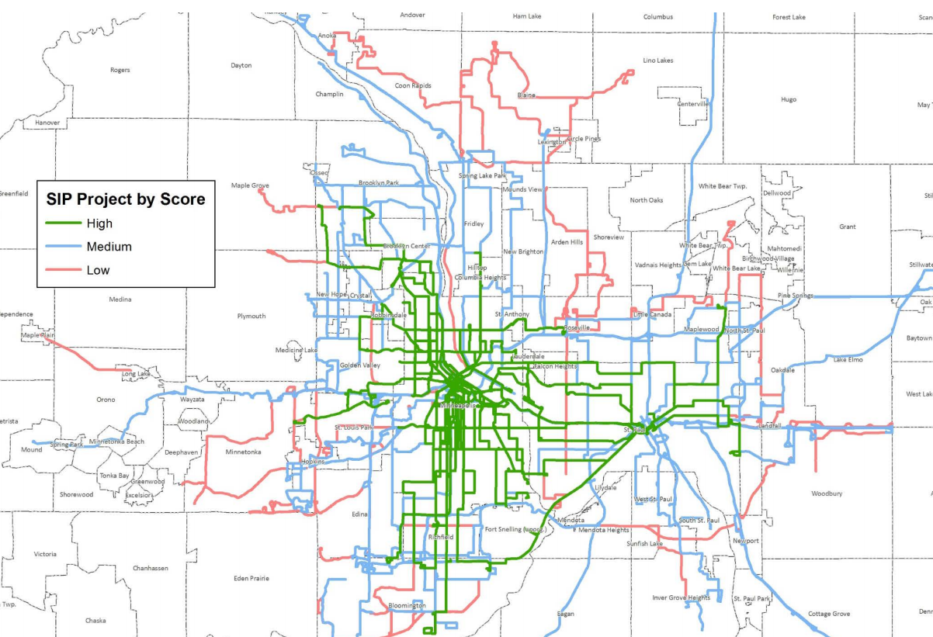
Notes:
As part of the PlanIt program, we have already conducted webinars and developed resources that will complement and reinforce what you hear today. In one that we presented recently, we covered the fundamentals of planning for transit, the region’s transit market areas, Metro Transit’s Service Improvement Plan, and comprehensive planning requirements for transit.

Slide 7
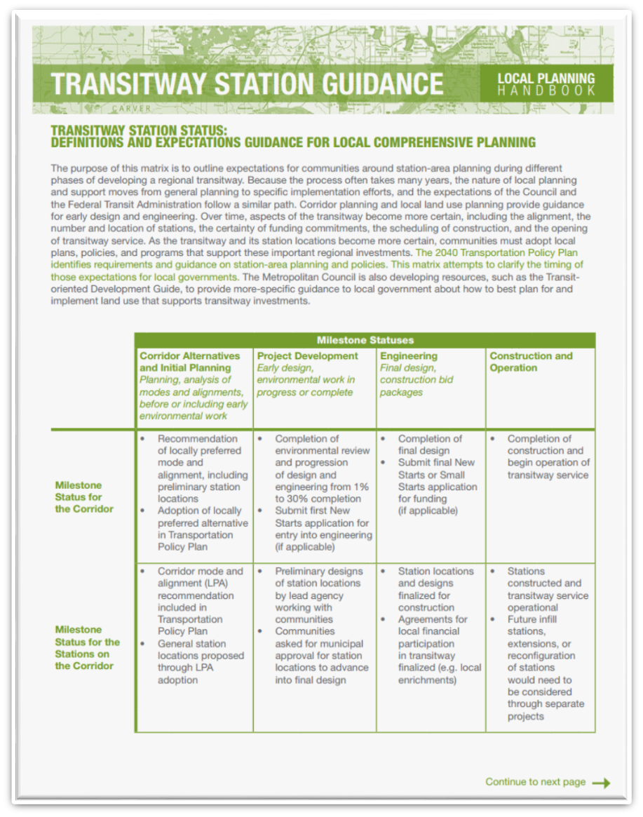
Notes:
One of the resources that has been developed for the Local Planning Handbook is the Fact Sheet on Transitway Station Guidance, which is available here as a handout. This resource articulates the different roles and responsibilities during the development of new transitways, including the timing of certain planning activities against key milestones. Comp plans need to include a discussion of these roles and the timing of these activities.
Even if you community does not have a future transitway, you may find this resource useful in how it lays the groundwork for increasing levels of commitment in support of transit.

Slide 8
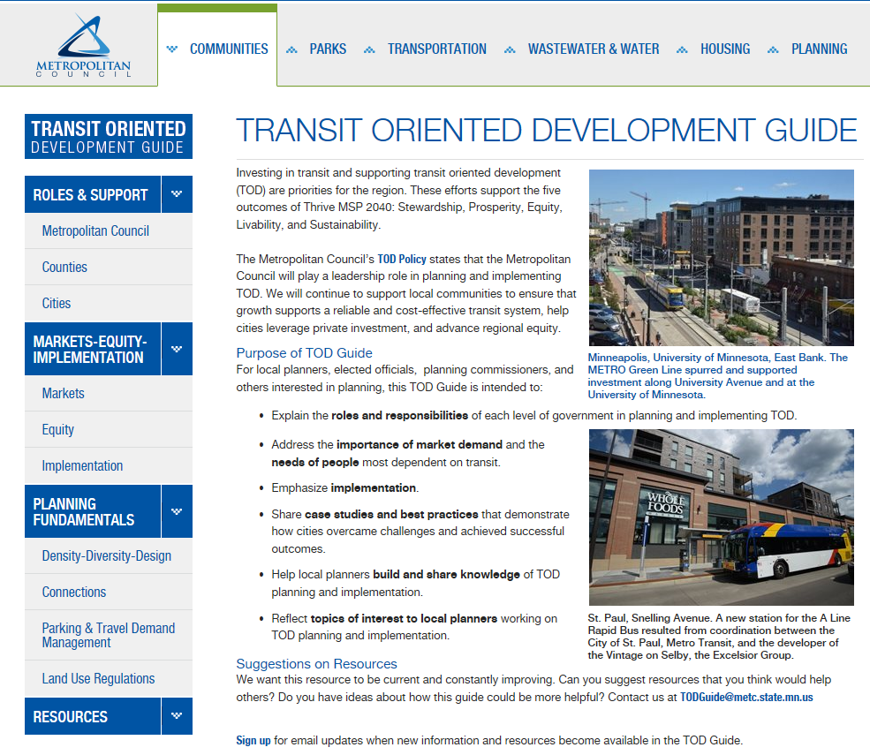
Notes:
Another resource is the Council’s online TOD Guide. This guide is intended to support TOD planning practice, connecting planners with information, ideas, and resources.
We encourage you to consider the TOD Guide’s language as a template for how you frame TOD planning issues in your community. We also encourage you to consider this as a resource as you engage community stakeholders and officials around the many dimensions of TOD, including density, connectivity, placemaking, and equity. Each of the sections has contact information for further engagement, as well as resources for further professional development. The Guide has a few sections under development, and we encourage feedback and suggestions.

Slide 9
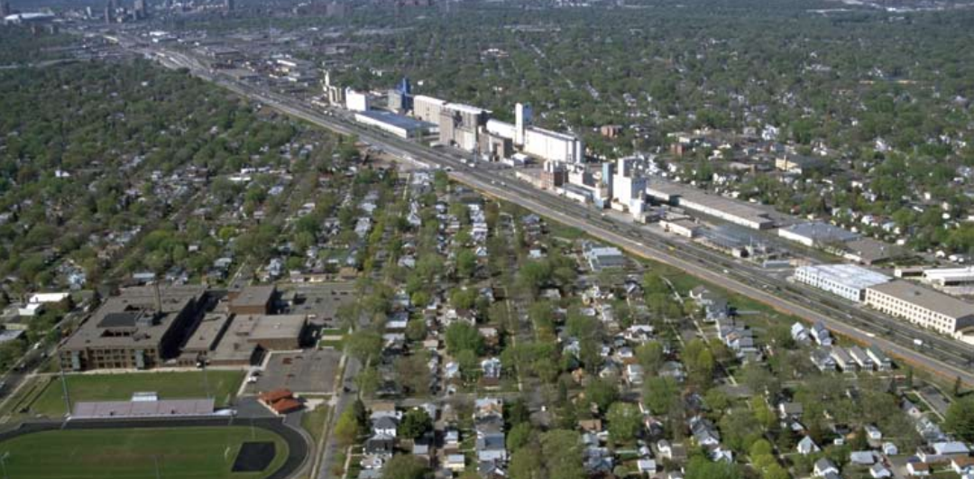
TOD in Comp Plan Exercise
Notes:
I’m now going to discuss TOD planning and policy for your comp plan by using a real life example, the 38th Street Station area on the METRO Blue Line. I will keep this fairly simple and generalize some details so that we can extrapolate to different kinds of transit.
This particular view is looking north, with Hiawatha Avenue and the light rail running north/northwest. Some of the large structures you see are ADM’s silos. The area has seen redevelopment, including Longfellow Station, a 180-unit mixed income project that replaced the Purina Mill. The Council is also involved in a joint development project at the station site.

Slide 10
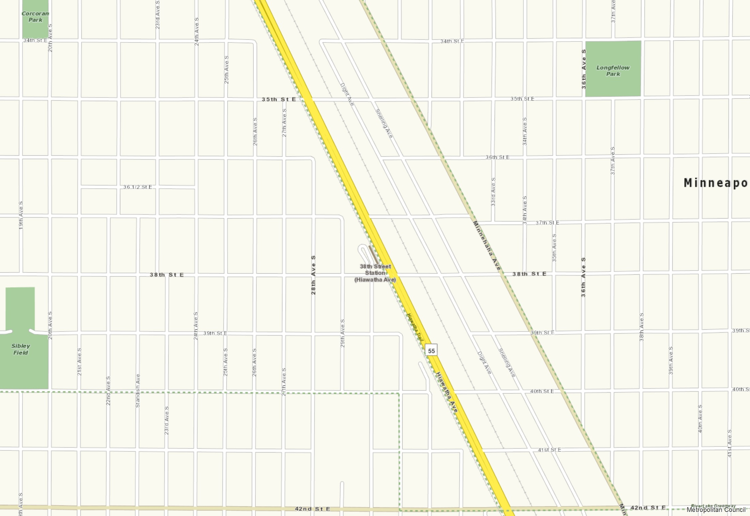
Base Map
Notes:
Let’s start with a simple base map of the area showing Hiawatha Avenue in the middle.

Slide 11
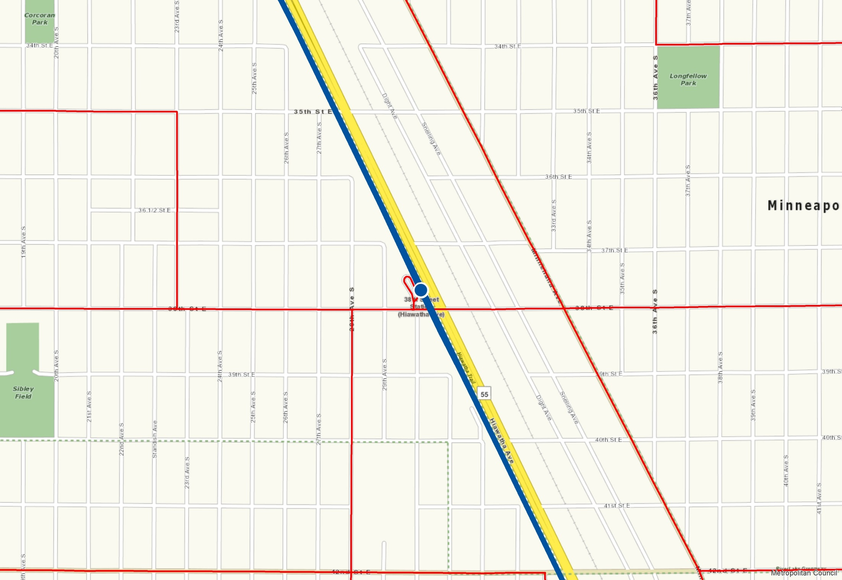
Map Transit
Notes:
First off, your comprehensive plan must incorporate regional transit infrastructure and services. In my example, the map shows the METRO Blue Line and local bus routes. Other transit features that your community has like park-and-rides, should be included. The Local Planning Handbook includes checklists and a range of data resources on existing and planned transit elements.

Slide 12
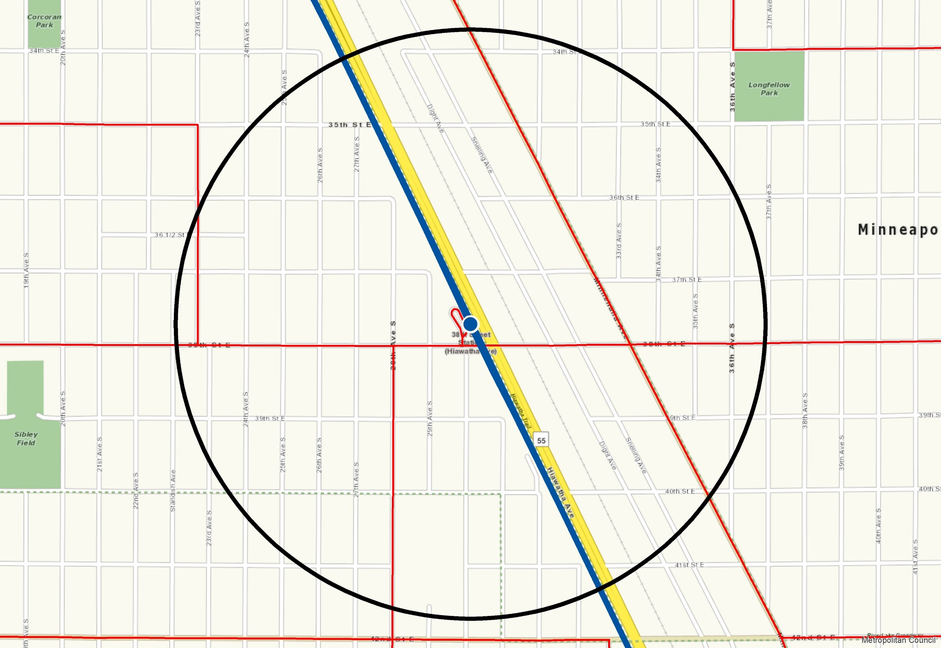
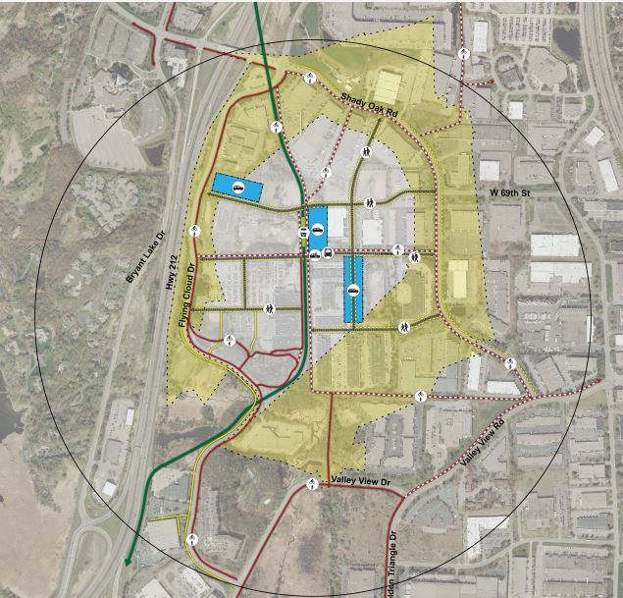
Map Transit Station Area
Notes:
Comprehensive plans must also identify station areas within which regional land use policies will apply.
In our case, we map the station area for the 38th Street station. This is ½ mile from the station, which roughly approximates a ten minute walk. As you know, actual walking distances will vary. Station area planning considers potential improvements to the directness and quality of walking routes, and many of you here have been part of planning analyses that have done just that.
(CLICK) Here is an example in Eden Prairie that shows, in yellow, how the area served by an actual ½-mile walking distance is improved with new connections. (CLICK)
For communities with local and express bus service, the same principles of proximity and connectivity apply. However, mapping station areas is not required.

Slide 13
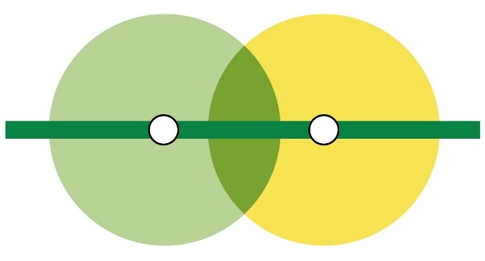
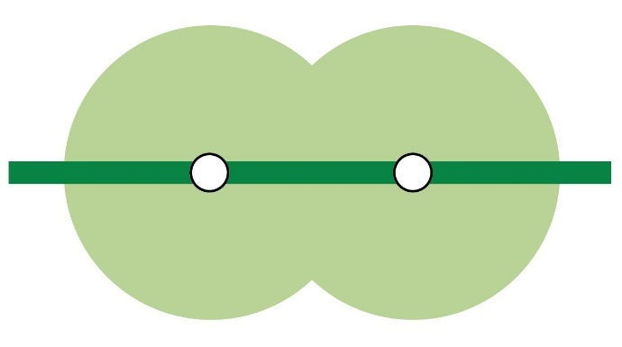
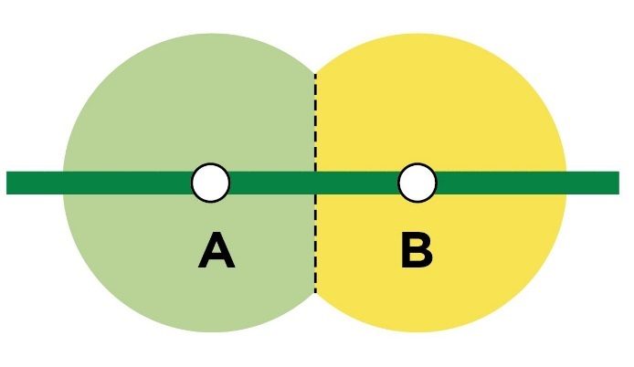
Mutually Exclusive Station Areas
Notes:
For BRT and LRT, your community may include stations that are spaced more closely together than one mile, which creates overlapping ½ mile areas, as illustrated in the graphic on the left. This is not a scenario communities with Commuter Rail would have. We suggest that you designate mutually exclusive station areas for planning and evaluation purposes. This avoids double counting and having to analyze the same area twice.
You can do this in one of two basic ways:
In the middle, a community creates a planning district that is served by two stations. Such might be the approach for downtown districts.
In the example on the right, a community splits the difference.
In your community’s situation, you may have other adjustments to this geography based on built and natural features (CLICK) that more obviously define accessibility to and from the station.

Slide 14
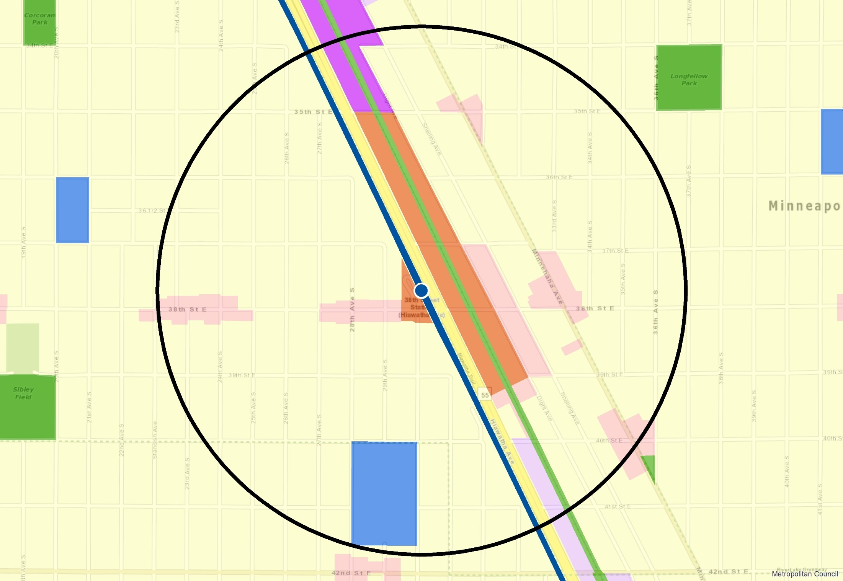
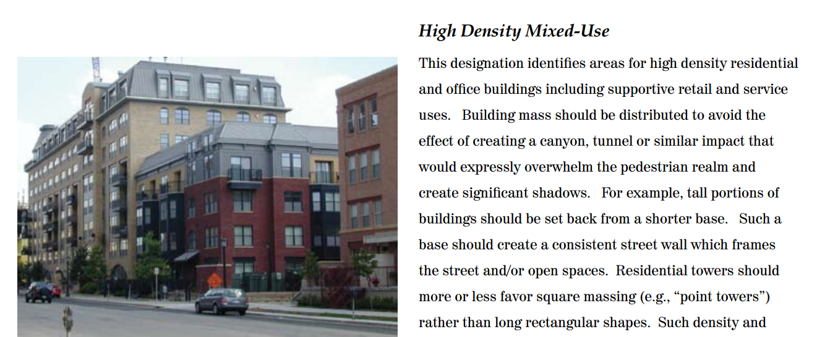
Guide Land Use
Notes:
As with the rest of your plan, stations must have guiding land use policy that is mapped and supported by policy descriptions that include assumptions about a density range for residential uses.
In our example, we’re showing that the existing low-density storage and warehouse uses are guided as High Density Mixed Use, (CLICK) shown in orange. The small area plan, which is incorporated into the comprehensive plan, articulates how the scale and design of this development should relate to the existing neighborhood, and the conditions under which it could occur.
(CLICK) The plan includes conceptual site plans and photos of existing development that represents these principles. These principles can set up future zoning code mapping and text changes to support the form and uses articulated in the plan. (CLICK)
Existing industrial uses at the periphery of the station area remain guided as Industrial, (CLICK).
Established small-scale neighborhood commercial uses are designated as Neighborhood Commercial Node, (CLICK) a guiding land use that permits small-scale stand-alone commercial as well as medium density mixed-use projects.
The majority of land in the station areas, shown in light yellow, is guided as Urban Neighborhood, to reflect the existing low-density, bungalow character of the neighborhood.
Supporting a range of uses in the station area is consistent with the Transportation Policy Plan, which calls for a mix of uses in the station areas.

Slide 15
Identify Infrastructure Needs
Notes:
In our example, there is the possibility of the eventual abandonment of the railroad spur. The plan envisions this is future trail or greenway. (CLICK) This part of the plan, however, remains conceptual due to the uncertainty of the long-term use of the rail spur. Your community may have similar land use and infrastructure challenges.
(CLICK) The plan also identifies a future bicycle connection to the station. Identifying needs like this is consistent with the Transportation Policy Plan, which calls for local communities to identify needed local infrastructure to support connections to transit. Walkability and connections to transit is important for all types of transit, whether it is a transitway like LRT, or a suburban local route.

Slide 16
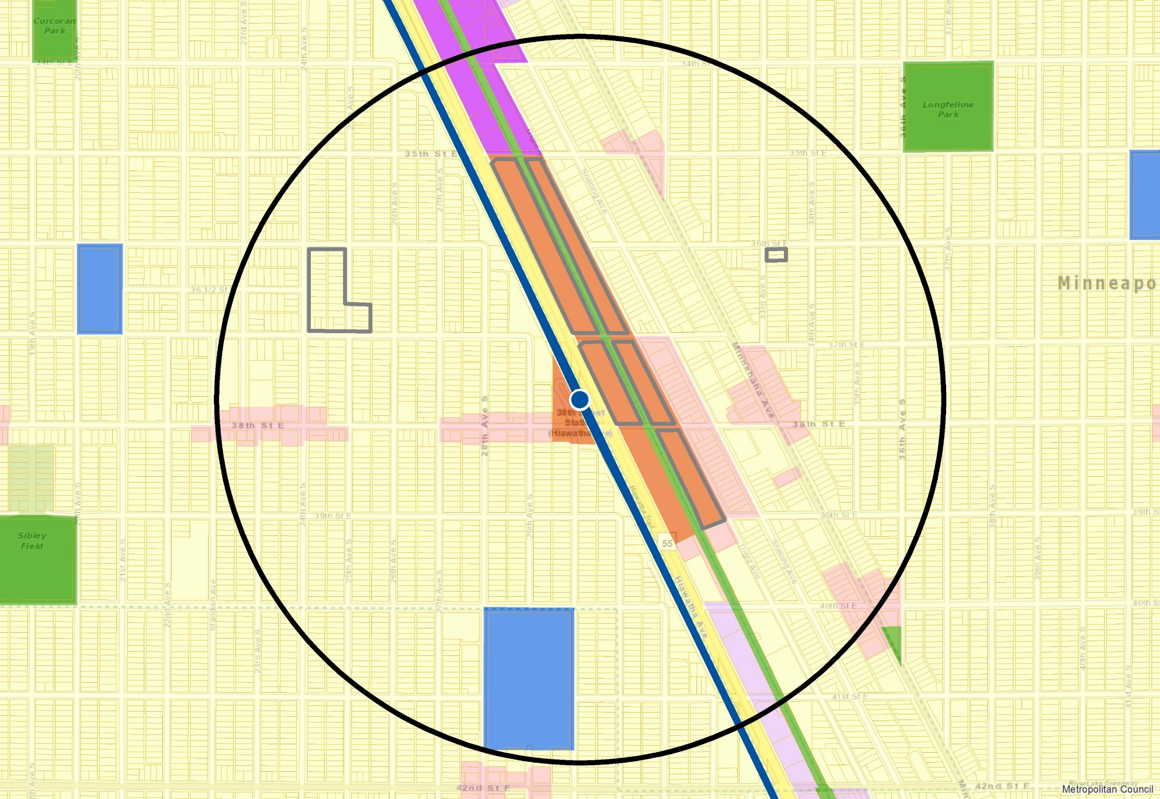
Density
Notes:
As with the rest of your comprehensive plan, the station area must identify sites where redevelopment may be more likely to occur. In our example, these areas are shown outlined in gray. Local planners use their professional analysis and judgment to identify these sites. We use this information to determine if a community can meet its growth forecast, and if guiding land use densities are consistent with regional policy.
In our example, much of the area expected for redevelopment is guided as High Density Mixed Use. A plan might also identify infill sites within lower density established areas, such as shown in the locations here (CLICK). Your community may see these as opportunities to accommodate higher density uses, or it may be appropriate for these areas to be guided similar to their surrounding uses, as is shown here.

Slide 17
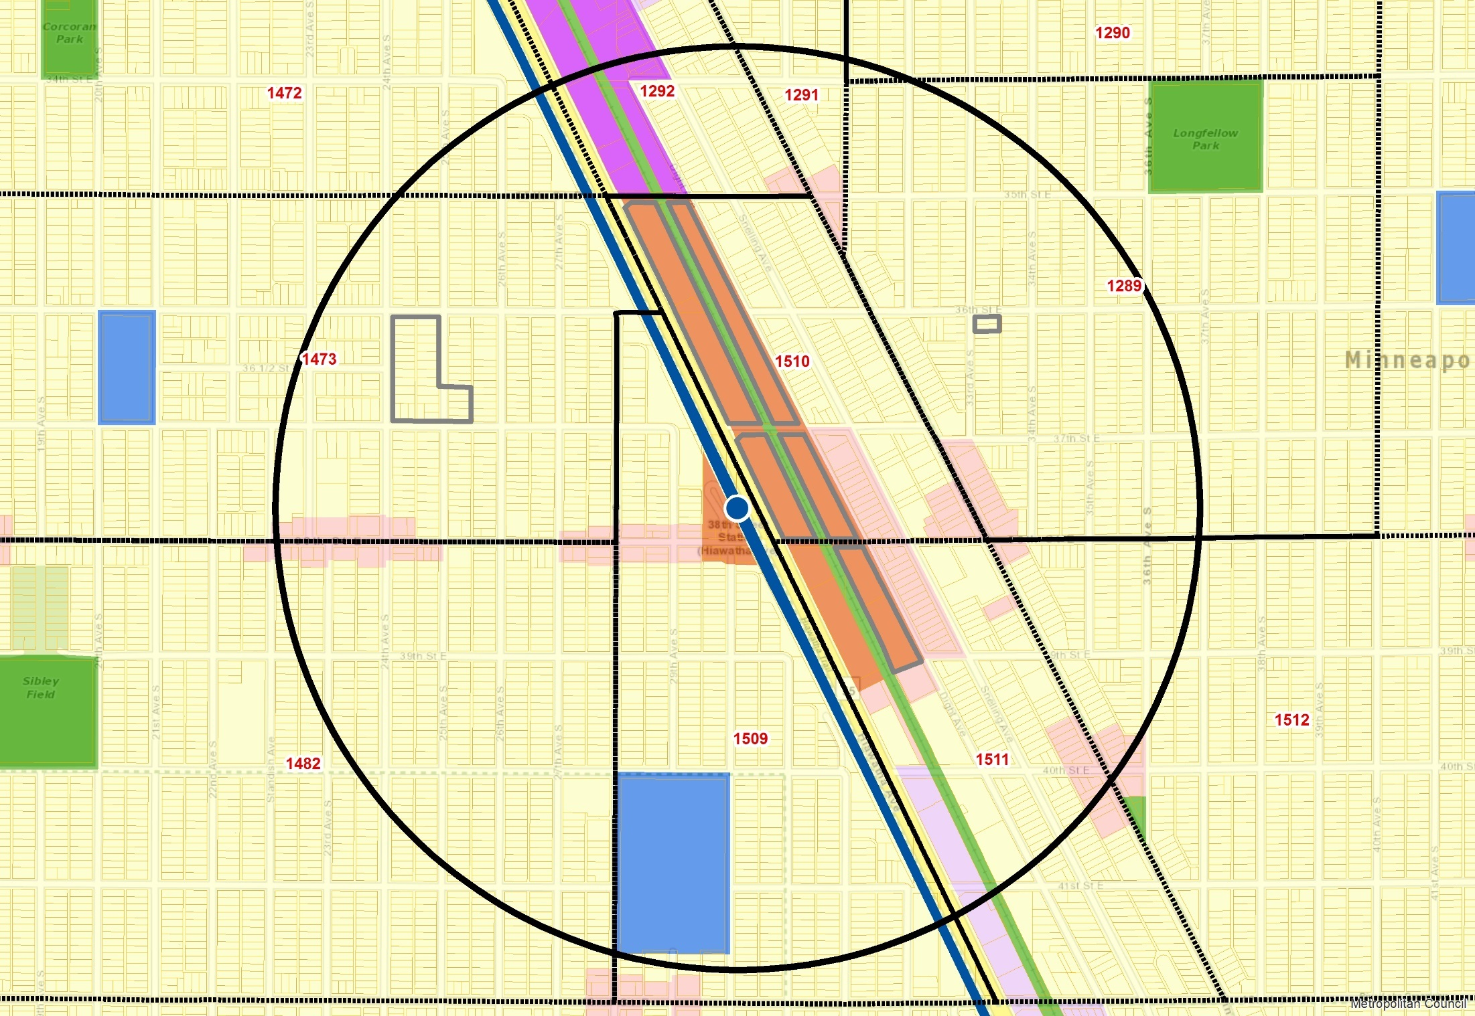
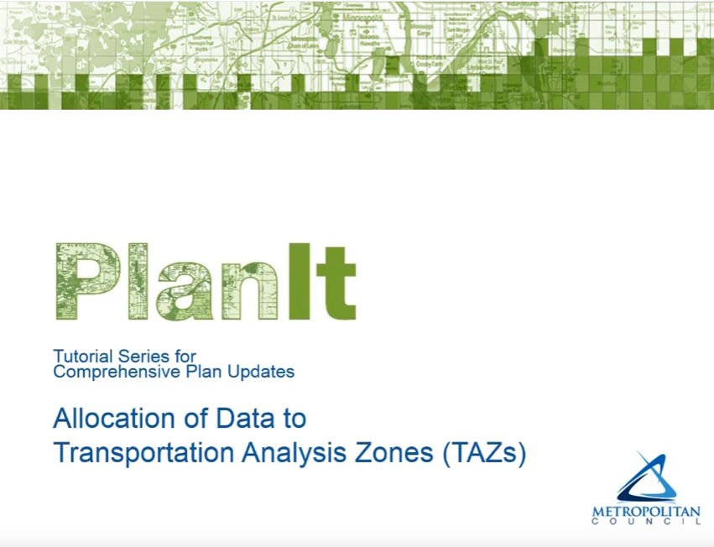
Growth Allocation
Notes:
In this slide I’ve added the TAZ boundaries or Transportation Analysis Zones. Communities must allocate their forecasted growth to this geographic unit. It is a policy of the Transportation Policy Plan to encourage communities to allocate growth near transit. Some communities may find that they can accommodate more growth near transit than is currently forecasted. However, TAZ allocations across the city must sum to the forecasted community totals. If growth occurs faster than expected, or if there is evidence that forecasts are too low, your community’s forecasts could be adjusted through the comp plan update or amendment process.
(CLICK) I encourage you to review the PlanIt online tutorial on TAZ allocation if you haven't already done so.

Slide 18
Residential Density
Applicable Transit Types
  Light Rail Transit (LRT)
  Commuter Rail
  Highway Bus Rapid Transit (BRT)
  Arterial BRT
  High Frequency Bus Routes
Does Not Apply
  Local bus routes
  Express bus routes
Notes:
I’d like to turn to some additional detail on density policy. It applies to the following transit types:
Light Rail Transit (LRT)
Commuter Rail
Highway Bus Rapid Transit (BRT)
Arterial BRT
High Frequency Bus Routes
(CLICK) There is one policy distinction for Arterial BRT stations and high frequency bus routes. The TPP density policy only applies to ¼ mile from the station, or 5-minute walk.
These specific policies do not apply to either local or express bus routes. However, communities can nevertheless support these services through the same principles of density and connectivity.

Slide 19
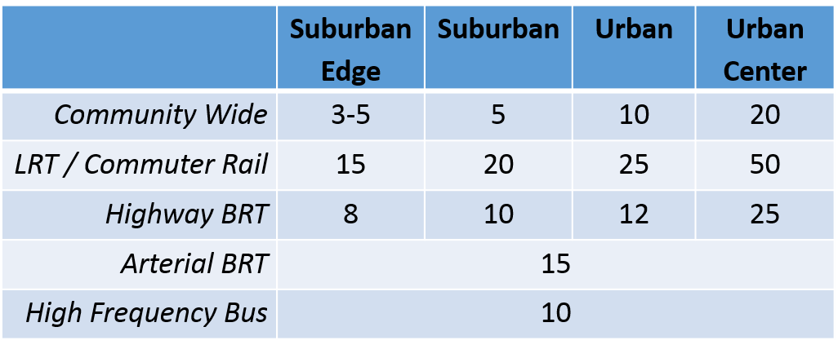
Residential Density (du/acre)
Notes:
The table shows the density requirements across community designations and transit type.
These minimums are weighted average of minimum guided densities. For example, if land is guided at 10-20 units per acre, 10 is the number we use. These minimums are informed by market conditions and land use context; and they only apply to areas guided for change.
Since these numbers are a weighted average, it is possible that some areas can be guided lower than these minimums. By definition, some areas would need to be guided at higher minimums.
(CLICK) Community wide density policy originates in Thrive and varies by community designation.
(CLICK) Density related to transit originates in the Transportation Policy Plan.
These densities vary by market opportunity and level of transit investment.
(CLICK) Urban Center communities have the overall highest density expectations across transit types.
(CLICK) And the more significant transit investments also have the highest density expectations across community designation types.

Slide 20
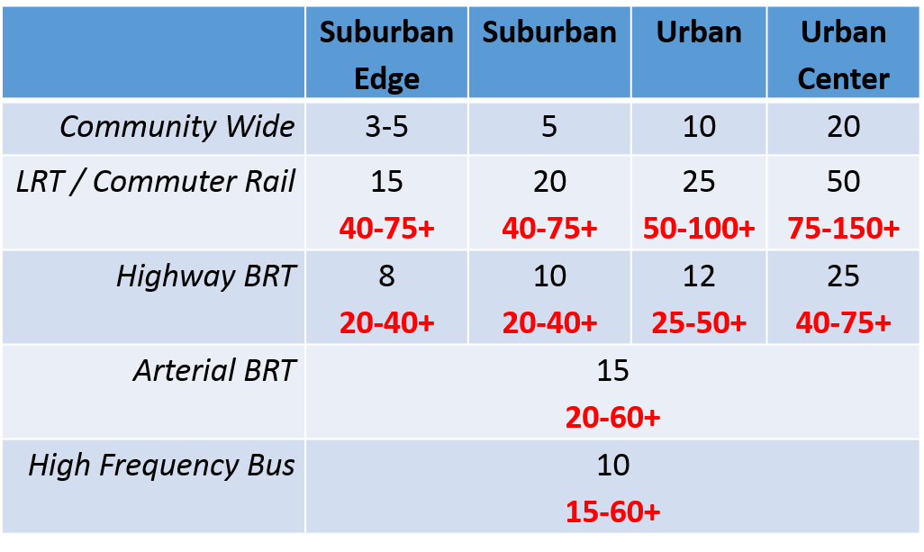
Residential Density (du/acre)
Notes:
I want to also point out that the Transportation Policy Plan also has suggested target ranges, shown in red, that are more supportive of transit, and reflect planning and market conditions where greater density may be feasible and appropriate. Your community may wish to consider where there may be appropriate opportunities for these ranges, from a market and an urban design standpoint.
I’m not covering it today, but there are a number of resources on visualizing density in its various forms. They’re included or referenced in the Transportation Policy Plan, TOD Guide, and Local Planning Handbook.

Slide 21
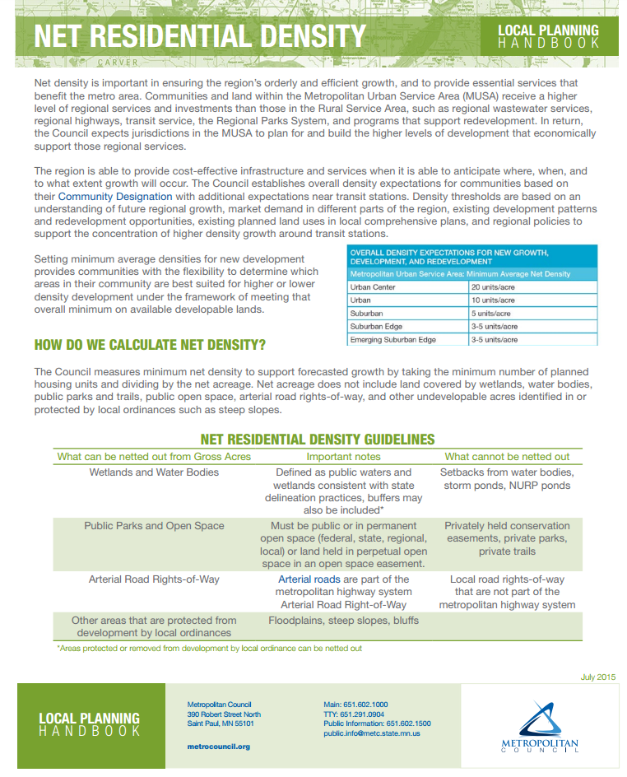
Notes:
The Local Planning Handbook Fact Sheet entitled Net Residential Density is a resource that provides further information on calculating planned densities. This resource will be most applicable to communities with greenfield development, as it discusses netting out certain land uses from overall density calculations.

Slide 22
Activity Levels for Station Areas
Encourage a mix of uses
Guideline of 7,000 residents, employees, or students
Consider market demand and readiness for redevelopment
Notes:
In addition to expectations for density of new residential development, the Transportation Policy Plan also includes policy on Activity Levels.
In order to maximize the benefit to transit riders and the transit system, local plans should encourage a mix of land uses that meet the needs of transit riders, residents, students, and employers. The mix will depend on local preferences and market conditions.
As I mentioned previously, the Thrive and the TPP encourage focusing growth near transit. The TPP includes a guideline that stations should accommodate a mix of 7,000 residents, employees, or students. Many station areas meet or far exceed this number. It’s meant to be a minimum benchmark to ensure that transit can effectively serve people and places, and that transit is an effective investment. It’s an overall level of development intensity that you might find in a typical urban neighborhood.
Nevertheless, in some locations, communities may face challenges meeting this number. If that is the case, we encourage communities to plan in ways such that development in the short-term does not preclude opportunities for greater level of activity in the future. Market studies and urban design studies can help shed light onto what might be possible for communities to achieve over time.
Finally, I will say that the Met Council is currently updating this data set so that communities have a benchmark from which to plan.

Slide 23
Data
Local Planning Handbook
Met Council Maps & Data
MN Geospatial Commons
Notes:
Finally, I want to mention that there are a number of data resources to help you plan for transit and TOD.
These include the Local Planning Handbook.
The Council also includes summary data at various geographic levels, including station areas.
And, you can go directly to MNGeo Commons for much of the same and additional transit related data, including shape files for station areas.
Finally, for questions on any of these resources or policy questions, your sector rep can be your first point of contact.

